Slide 1

2025 CAIRIBU Research Strategy Sprint
NIDDK Urology Program Areas:
UroBiome, UroAging, and UroVoiding
Chris Mullins, PhD
Director of Cell Biology Programs in Urologic and Kidney Disease
Project Scientist for the NIDDK Urology Centers Program
Division of Kidney, Urologic and Hematologic Diseases (KUH)
National Institute of Diabetes and Digestive and Kidney Diseases (NIDDK)
National Institutes of Health (NIH)

Slide 2
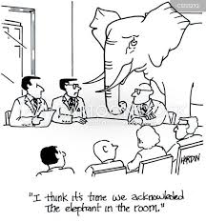

What’s Going on at the NIH…??
Watch for Facts
and Public
Information,
Not Rumors!

Slide 3
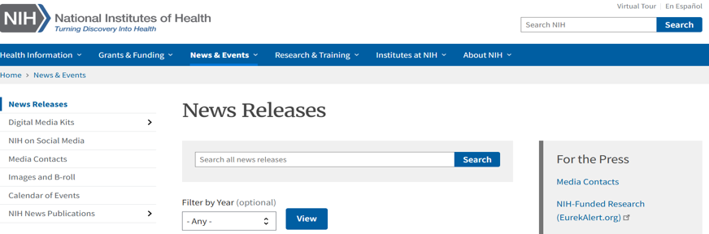

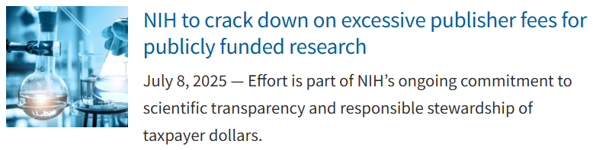
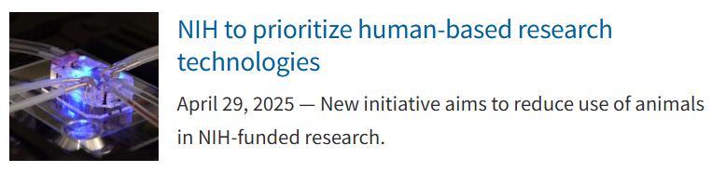
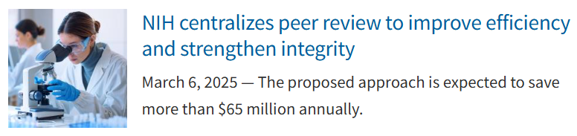
Where Do I Find Updates on Changes at the NIH??
NIH Home Page: https://www.nih.gov/

Slide 4
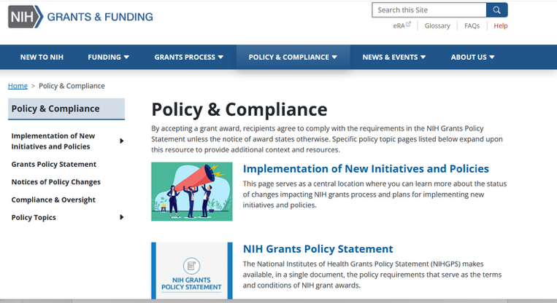

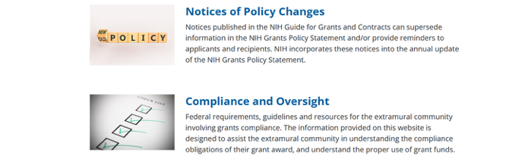
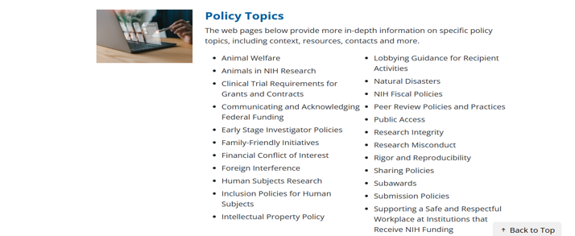
Where Do I Find Updates on Changes at the NIH??
NIH Home Page: https://www.nih.gov/
“Explore Policy
and Compliance”
New & Planned
Changes
NIH Guide
Notices
Policies by Topic

Slide 5
A Few Things to Remember….
Again - Look for Facts and Public Information!
Federal Budget Reconciliation versus Discretionary Process
    Fiscal Year 2026 NIH Budget?
    NIH Reorganization?
    Other?
Notifications of Policy Changes Don’t Always Immediately Translate into Actionable Procedures for You or NIH Staff!
Please Be Patient. We Are Working on It...!
Most Importantly: The NIDDK Continues to Serve the Research Community and Support High-Impact Research and Training.
So Write Those Applications!!

Slide 6
KUH, NIDDK is the NIH’s Primary Home for Non-Cancer Urologic Disease Research and Training
Office of the Director
Griffin Rodgers, MD
Urology Program Mission Areas
Benign prostatic hyperplasia, urinary incontinence, urinary tract infections, stone disease, erectile dysfunction, urologic chronic pelvic pain syndrome (including interstitial cystitis and chronic prostatitis), congenital urologic disorders, repair and regeneration of lower urinary tract organs, and normal and abnormal lower urinary tract development and physiology.
Division of Diabetes, Endocrinology, and Metabolic Diseases
Division of Digestive Diseases and Nutrition
Division of Kidney, Urologic, and Hematologic Diseases
MISSION: Research related to digestive diseases, including the alimentary tract, liver and pancreas, nutrition and obesity. The programs include basic, translational and clinical research, research training, and career development. DDN also promotes public awareness and education for these areas.
MISSION: Basic and clinical research in the areas of type 1 and type 2 diabetes and other metabolic disorders, including cystic fibrosis; endocrinology and endocrine disorders; obesity, neuroendocrinology, and energy balance; and development, metabolism, and basic biology of liver, fat, and endocrine tissues. DEM also supports training and career development in these areas.
MISSION: Basic, translational, and clinical research of the kidney, urinary tract, and disorders of the blood and blood-forming organs, as well as training and career development in these areas.
Notes:
13
13
Not shown: Office of Minority Health Research Coordination, Office of Obesity Research. Also housed within NIDDK is NIH’s Division of Nutrition Research Coordination

Slide 7
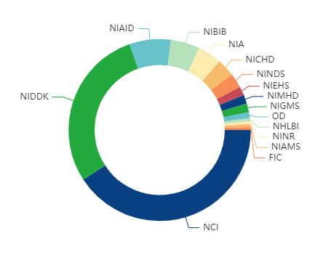
Urology Research is a Shared Interest Among Numerous NIH Institutes
Urology Research Projects Across NIH Institutes:
NINR
NIDDK
NIAID
Bladder Infection
NICHD
NCCIH
NIA
Urinary
Incontinence
NIDDK
NICHD
NCCIH
NIA
NINR
NICHD
NIDDK
NINDS
Urologic Aging
NIA
Notes:
Complementary and Integrative Health
Nursing Research

Slide 8
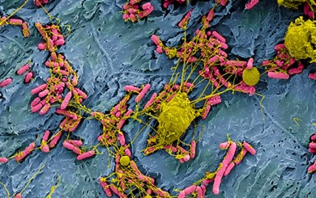

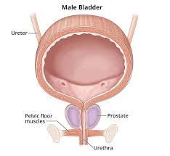
NIDDK Uro-Biome/Aging/Voiding Mission Areas Include
(but not limited to):
UroBiome
  Urinary Stone Disease
  Urologic Chronic Pelvic Pain Syndrome
  Broad Bladder/Prostate/Lower Urinary Tract Dysfunction
  Broad Urologic Infections and Inflammation (e.g., UTIs, CAUTIs, AB)
UroAging
  Progressive Urologic Conditions (e.g., BPH/LUTS, UI, OAB, UAB)
  Sexual Health (Non-Reproductive) (e.g., ED, Peyronie`s Disease)
  Urologic Complications of Obesity and Kidney Disease
  Genitourinary Syndrome of Menopause (GSM)
  Translational Research Related to Pediatric Urologic Health
UroVoiding
  Broad Prostate/Lower Urinary Tract Dysfunction (e.g., BPH/LUTS, UI)
  Urologic Complications of Injury (e.g., SCI)
  Complications of Congenital Disorders (e.g., Spina Bifida, VUR, Hypospadias)
  Neurogenic Bladder and Under/Over-Active Bladder

Slide 9
NIDDK Uro-Biome/Aging/Voiding Mission Areas Include
(but not limited to):
UroBiome
  Urinary Stone Disease
  Urologic Chronic Pelvic Pain Syndrome
  Broad Bladder/Prostate/Lower Urinary Tract Dysfunction
  Broad Urologic Infections and Inflammation (e.g., UTIs, CAUTIs, AB)
UroAging
  Progressive Urologic Conditions (e.g., BPH/LUTS, UI, OAB, UAB)
  Sexual Health (non-reproductive) (e.g., ED, Peyronie`s Disease)
  Urologic Complications of Obesity and Kidney Disease
  Genitourinary Syndrome of Menopause (GSM)
  Translational Research Related to Pediatric Urologic Health
UroVoiding
  Broad Prostate/Lower Urinary Tract Dysfunction (e.g., BPH/LUTS, UI)
  Urologic Complications of Injury (e.g., SCI)
  Complications of Congenital Disorders (e.g., Spina Bifida, VUR, Hypospadias)
  Neurogenic Bladder and Under/Over-Active Bladder

Slide 10
Selected Research Topics of Interest (but not limited to):
Host-Pathogen and Microbe-Microbe Interactions in Urologic Infections
Contributions of – and Changes to - the Urologic Microbiome in Disease Development
Distinct Patient Sub-groups (Phenotypes) to Inform Therapy Selection/Testing
Contributions of the CNS and/or Peripheral Neurobiology in Urologic Disease
Development and Application of New Tools/Approaches/Resources/Technologies/Devices
Characterization of “Healthy” (“Normal”) Urologic Function
Identification of Risk Factors for Disease (e.g., Early-in-Life, Behavioral, Environmental)
Underlying Mechanisms and Prevention of Urologic Disorders
Novel Clinical Trial Designs and Development of New Therapeutic Approaches
Effective Application of Artificial Intelligence and Machine Learning Approaches

Slide 11
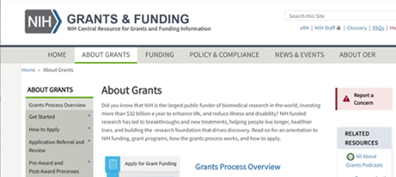

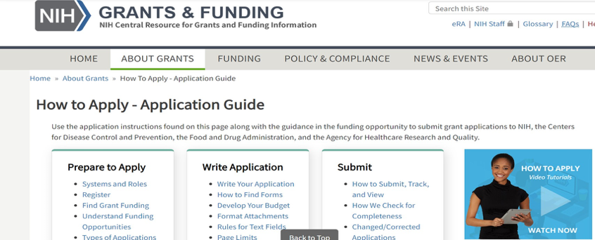
NIH On-Line Resources for Getting Started
NIH Grants and Funding Home Page
https://grants.nih.gov/
One-stop site for information about NIH
application, review, and award process
https://grants.nih.gov/grants/about_grants.htm
Links to navigate to all steps, funding policies and history, key resources, etc
https://grants.nih.gov/grants/how-to-apply-application-guide.html

Slide 12
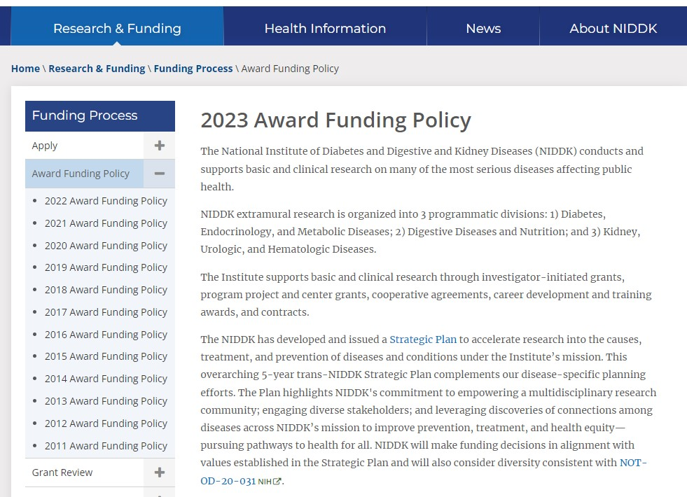
Will I be Funded….and How Much and How Long?
NIDDK Funding Policies are posted every Fiscal Year
Most applications (e.g., R01s) are funded based on
established “Pay Lines” (reviewed applications are
usually ordered based on percentile scores).
Sometimes we can “reach” beyond the Pay Line to
make limited, discretionary awards
Funding decisions for many award types are impacted
by other criteria (e.g., specifics of the solicitation)
All funding decisions involve multiple levels of review
and a final review by the NIDDK Advisory Council
NIDDK 2023 Award Funding Policy: https://www.niddk.nih.gov/research-funding/process/award-funding-policy

Slide 13
What if You’re NOT Funded:
NIH Resubmission Policy (e.g., for a R01)
If your NEW Application (A0) is FUNDED then GREAT!
If your NEW Application (A0) is NOT FUNDED you may submit:
  A Revised Resubmission Application (A1) or
  A NEW Application (A0)
If the Resubmission Application (A1) is NOT FUNDED you must submit a NEW Application (A0) (NOTE: The second Resubmission Application (A2) was eliminated)
NIH Will Not Accept:
  An A0 or A1 application that overlaps with a funded application
  Simultaneous submissions of overlapping applications
  An A0 or A1 application before NIH issues the summary statement of an earlier, overlapping application
Resubmission FAQs: Many Scenarios and Requirements
http://grants.nih.gov/grants/policy/resubmission_q&a.htm

Slide 14
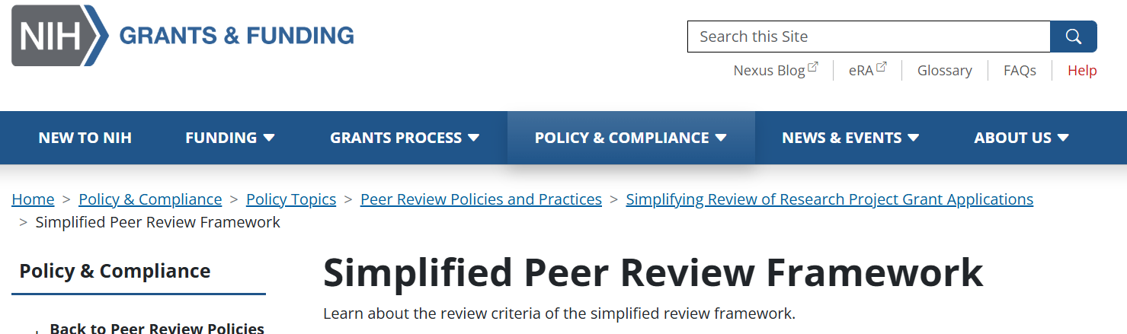
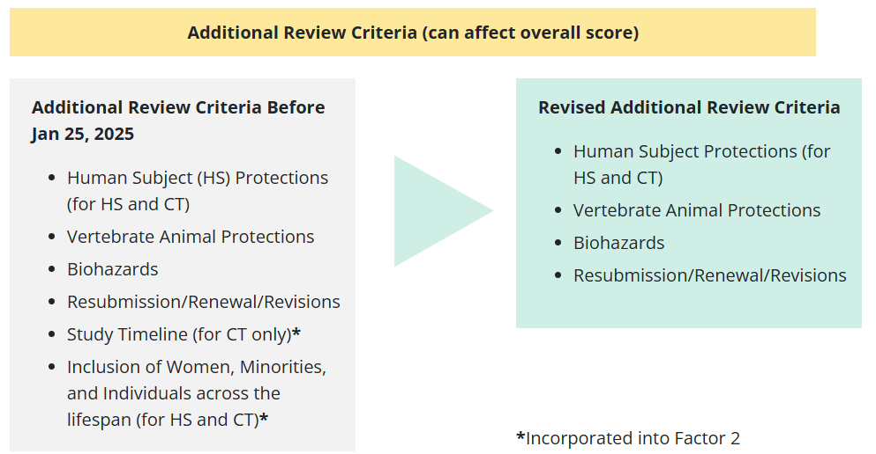
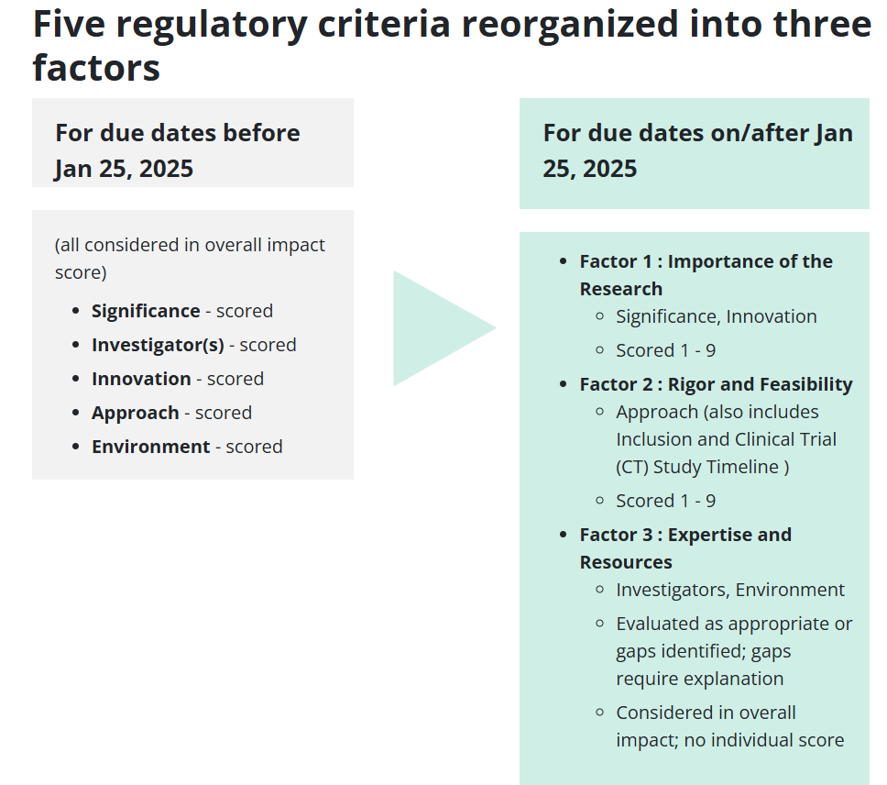
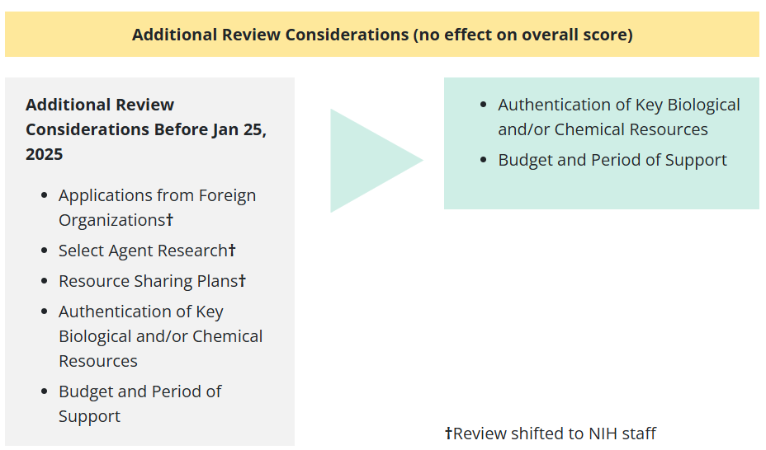
Big Changes for NIH Peer Review!
Reframed Criteria Focus:
Importance of the Proposed
  Research
Rigor/Feasibility of Methods
Expertise/Resources
Overall Score/Percentile
Still Provided
Additional Review
Considerations
NIH Grants and Funding: Simplified Review Framework:
https://grants.nih.gov/policy-and-compliance/policy-topics/peer-review/simplifying-review/framework

Slide 15
A Few Grant Writing Tips…..
Know your audience: Reviewers!
    Not every reviewer is an expert on all aspects of your proposal
    Make the job of reading your application easy (e.g., Figure size, white space, etc)
Ask collaborators and non-collaborators to pre-review the ideas/application (the more eyes the better; gather opinions) and PROOF-READ!
Know your receipt date and work back to plan writing (i.e., not last minute)
Late applications (even by a minute) are not accepted - so submit early!
Write to meet the review criteria (especially true for a special Funding Announcement)
Is it too ambitious? Match experiments to requested funds, award period, and expertise
If in doubt discuss mission- and award-type fit, eligibility, and current policies with NIH Program Staff before submission (before writing!)
Take advantage of the many NIH resources!

Slide 16
Select NIDDK Funding Opportunities
  NIH Research Project Grant: “Parent R01” Announcements
    Default solicitations for R01s; Standard Receipt Dates
  PA-25-301 NIH Research Project Grant (Clinical Trial Not Allowed)
    https://grants.nih.gov/grants/guide/pa-files/PA-25-301.html
  PA-25-303 NIH Research Project Grant (Basic Experimental Studies w/ Humans Required)
    https://grants.nih.gov/grants/guide/pa-files/PA-25-303.html
  PA-25-305 NIH Research Project Grant (Clinical Trial Required)
    https://grants.nih.gov/grants/guide/pa-files/PA-25-305.html

Slide 17
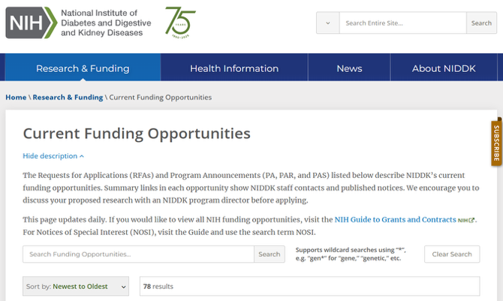
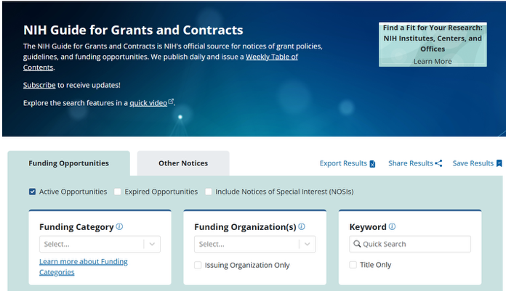
Select NIDDK Funding Opportunities
  Small R01s for Clinical Trials Targeting Diseases within the Mission of the NIDDK (Clinical Trial Required)
    PAS-25-102 https://grants.nih.gov/grants/guide/pa-files/pas-25-102.html
    Pilot/Feasibility trial to inform a larger, future trial
    Receipt dates into 2026
NIDDK Current Opportunities
NIH Grants and Funding
Search for
Funding
Opportunities
Further Updates
in Question
https://www.niddk.nih.gov/research-funding
/current-opportunities
https://grants.nih.gov/funding/
nih-guide-for-grants-and-contracts

Slide 18
Are You a New and/or Early-Stage Investigator?
  New Investigator (NI)
    PD/PI who has not yet competed successfully for a substantial NIH independent research award
  Early-Stage Investigator (ESI)
    PD/PI who qualifies as a New Investigator AND is within 10 years of completing the terminal research degree or medical residency (or equivalent)
    Significant emphasis on supporting ESIs (e.g., funding considerations), including preferential R01 Pay Line (approx. 10% higher in FY23-24) first award and for first renewal (approx. 2% higher in FY23-24). FY26 and forward TBD…
    NOTE: An ESI as part of a MPI award with other non-ESIs will lose ESI status if funded. All PIs on a MPI application must be ESIs for ESI funding consideration.
  For Information on ESI Policy See: https://grants.nih.gov/policy/early-stage/index.htm

Slide 19
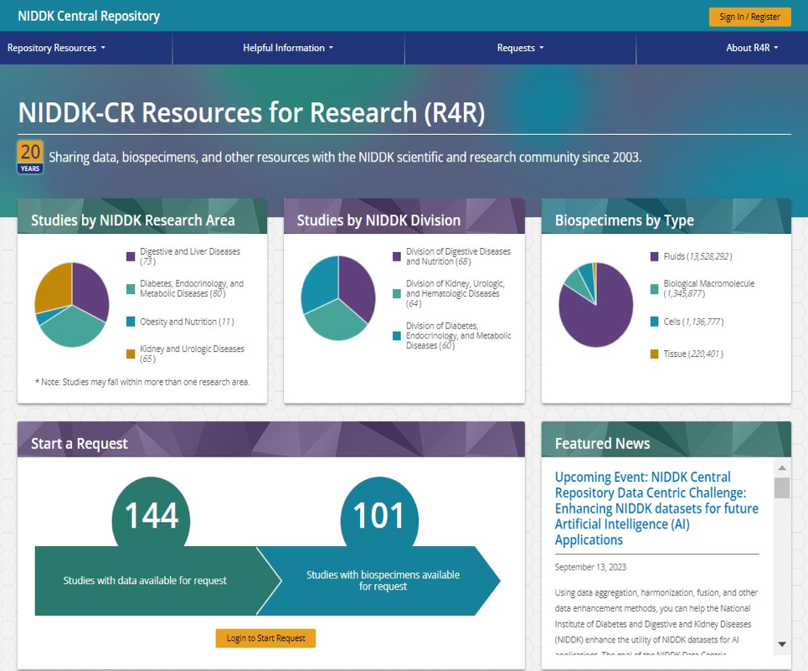
The NIDDK Central Repository
Jumpstart Your Research Study!
Receive access to archived clinical data
and diverse, associated biospecimens and
other materials from large, multi-site NIDDK
clinical trials and studies
What’s There? Searchable for study names,
resources categories, and key words
How? Pathways/Processes for Data and
Biospecimen Requests
NIDDK CR: https://repository.niddk.nih.gov/home/

Slide 20
Questions? Contact your Program Officer
https://grants.nih.gov/policy/natural-disasters/corona-virus.htm
A Few Examples of the Information You May Receive:
  Advice on relevance to the NIDDK’s mission and the right award type for the proposed study
  Help in navigating the NIH grants process and timelines: Before submission, after review, and during the project period….and some steps in between
  Sometimes direction toward a better contact, e.g., a different Program Officer at the NIDDK or a different Institute or a colleague in the Grants Management Branch or Review
  Information on additional, broad scientific and administrative considerations!
  Award Status (be aware we’re juggling many new policies and continuing changes)
A Couple of Good Practices:
  Useful to send a quick e-mail and perhaps a one-pager (draft aims) as a start and better than a “cold-call”
  Some basic questions can be addressed by a simple e-mail while others require a phone call, especially for junior investigators…and if we don’t answer after a bit please check back!

Slide 21

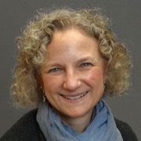
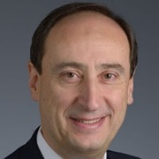

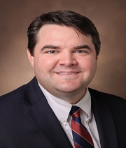
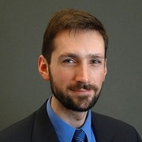
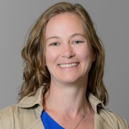


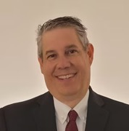
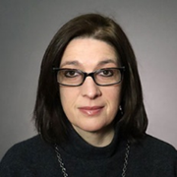
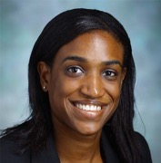
Contact the NIDDK Urology Program Staff !
Robert Star, MD
Director, KUH
robertstar@nih.gov
Tracy Rankin, PhD, MPH
Deputy Director, KUH
Career Development, Diabetic Uropathy; Endocrinology
tracy.rankin@nih.gov
Ziya Kirkali, MD
Clinical Urology; Erectile Dysfunction; Urology HIV/AIDS
ziya.kirkali@nih.gov
Chris Mullins, PhD
Cell Biology Programs in Kidney and Urologic Disease mullinsc@mail.nih.gov
Stuart Reynolds MD, MPH
Senior Advisor
Urology Programs
william.reynolds@nih.gov
Danny Gossett, PhD
Small Business, Tech Development; Translation daniel.gossett@nih.gov
Contact the NIDDK Urology Program Staff !
Jenna Norton, PhD, MPH
Health Equity, Social Determinants
jenna.norton@nih.gov
Debbie Gipson, MS, MD
Precision Clinical Trials,
Pediatric Urology
debbie.gipson@nih.gov
Deepak Nihalani, PhD
Kidney and Urology Centers Programs deepak.nihalani@nih.gov
Eric Brunskill, PhD
Developmental Biology, Regeneration and Repair; Omics Research
eric.brunskill@nih.gov
Raquel Greer, MD
Health Equity; Health Services
Research; Dissemination and
Implementation Research
raquel.greer@nih.gov
Christine Maric-Bilkan, PhD
NRSA Fellowship Awards, F99/K00
christine.maric-bilkan@nih.gov
NIDDK Home Page for Kidney, Urology, Hematology Research:
https://www.niddk.nih.gov/about-niddk/offices-divisions/division-kidney-urologic-hematologic-diseases

Slide 22

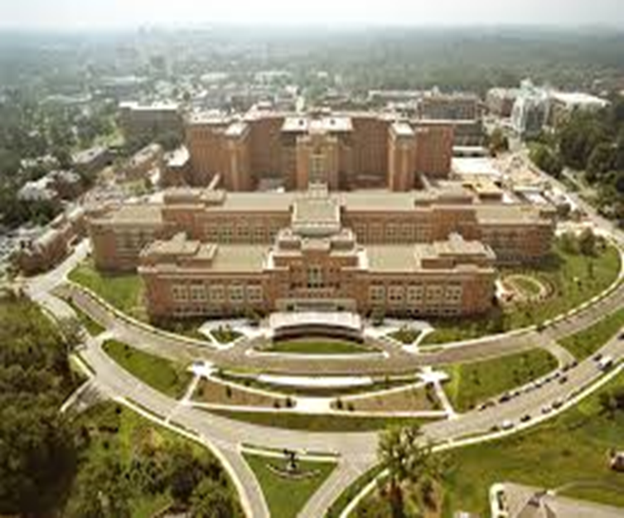
The NIDDK Remains Committed to Our Mission and to You….
NIDDK Mission:
Conduct and support medical research and research training and to disseminate science-based information on diabetes and other endocrine and metabolic diseases; digestive diseases, nutritional disorders, and obesity; and kidney, urologic, and hematologic diseases, to improve people’s health and quality of life.
Issuing New and Yearly Non-Competing Awards as
Rapidly as Possible with Adherence to Evolving Policies
Support of New, Junior, and Early-Stage Investigators
Strong Advocacy for All NIDDK Scientific Programs
You and Your Team Are Not Forgotten Here!
Everyone I Work with is Exceptional and Dedicated

Slide 23


Questions?

