Slide 1
CAIRIBU Research Strategy Sprint 2025
William (Stuart) Reynolds, MD, MPH
Program Official
Division of Kidney, Urology, & Hematology

Slide 2
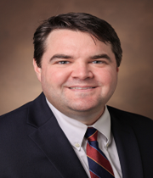
Bio: Stu Reynolds
Urologist, Specialist in Urogynecology and Reconstructive Pelvic Surgery
Previously Academic Urology (Vanderbilt University, Nashville, TN)
  Joined NIDDK in September 2024
Grant/Research history:
  Institutional Career Development Award (MPH degree)
  Individual Career Development Award (K23)
  Loan Repayment Program (>$150K pay-off)
  R01s
Research foci:
  Topic: OAB: Biopsychosocial impacts and underlying pain mechanisms
  Goal: applied (basic) research in humans

Slide 3
My NIDDK Role(s)
Program Director: Urology Training Grants
  Individual (Career Development Grants, K23)
  Institutional K12 programs
    K12 Urological Epidemiology Institutional Research Career Development Programs (KUroEpi)
    K12 Multidisciplinary Urologic Research Career Development Programs (KURe)
Program Official:
  Clinical and translational research
  Functional and Neurourology, Women’s urology and Reconstruction, and Pediatric and Aging urology

Slide 4
Disclaimers
Some things reflect NIH/NIDDK (beginning slides)
Some things do not reflect NIH/NIDDK – my own opinions/thoughts
…and I’m still learning the difference…

Slide 5

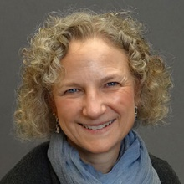
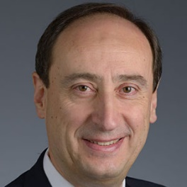


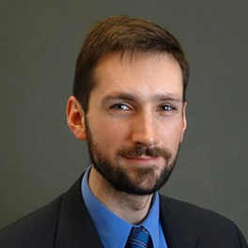

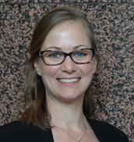

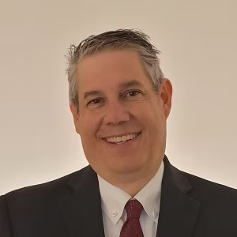
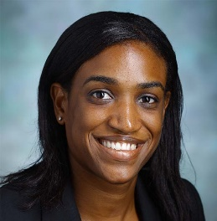

Contact the NIDDK Urology Program Staff!
Robert Star, MD
Director, KUH
robertstar@nih.gov
Tracy Rankin, PhD, MPH
Deputy Director, KUH
Career Development, Diabetic Uropathy; Endocrinology
tracy.rankin@nih.gov
Ziya Kirkali, MD
Clinical Urology; Erectile Dysfunction; Urology HIV/AIDS
ziya.kirkali@nih.gov
Chris Mullins, PhD
Cell Biology Programs in Kidney and Urologic Disease mullinsc@mail.nih.gov
Stuart Reynolds MD, MPH
Senior Advisor
Urology Programs
william.reynolds@nih.gov
Danny Gossett, PhD
Small Business, Tech Development; Translation daniel.gossett@nih.gov
Contact the NIDDK Urology Program Staff !
Debbie Gipson, MS, MD
Precision Clinical Trials,
Pediatric Urology
debbie.gipson@nih.gov
Jenna Norton, PhD, MPH
Health Equity, Social Determinants
jenna.norton@nih.gov
Deepak Nihalani, PhD
Kidney and Urology Centers Programs deepak.nihalani@nih.gov
Eric Brunskill, PhD
Developmental Biology, Regeneration and Repair; Omics Research
eric.brunskill@nih.gov
Raquel Greer, MD
Health Equity; Health Services
Research; Dissemination and
Implementation Research
raquel.greer@nih.gov
Christine Maric-Bilkan, PhD
NRSA Fellowship Awards, F99/K00
christine.maric-bilkan@nih.gov

Slide 6
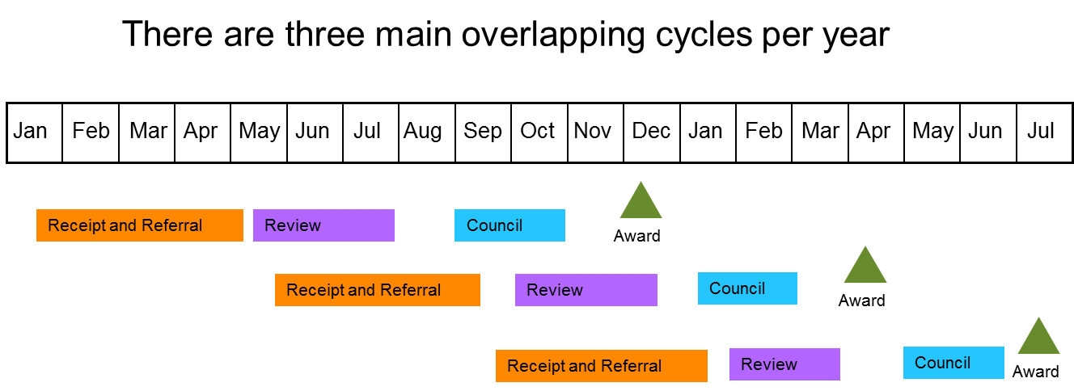
“General” Time frame from Submission to Award
Three (Primary) Funding Cycles Per Calendar Year Anchored to Three Council Meetings
However, our FISCAL YEAR is October 1st through September 30th
(So FISCAL YEAR order is October, January, and May Council Rounds)
Application Due Dates/Timelines:
https://grants.nih.gov/grants/how-to-apply-application-guide/due-dates-and-submission-policies/due-dates.htm

Slide 7
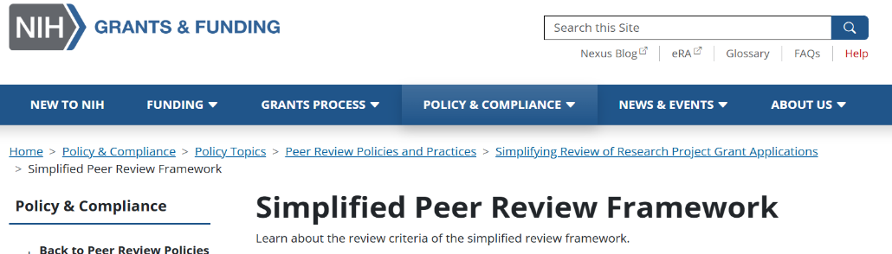
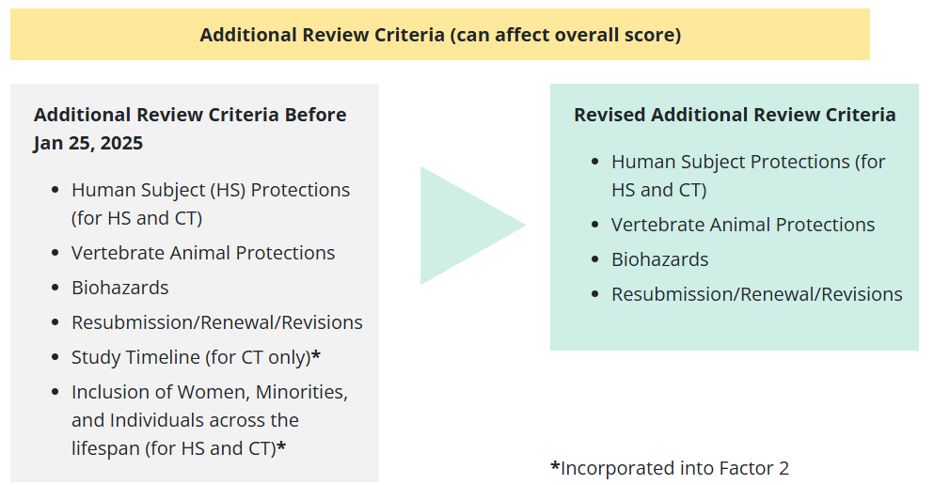
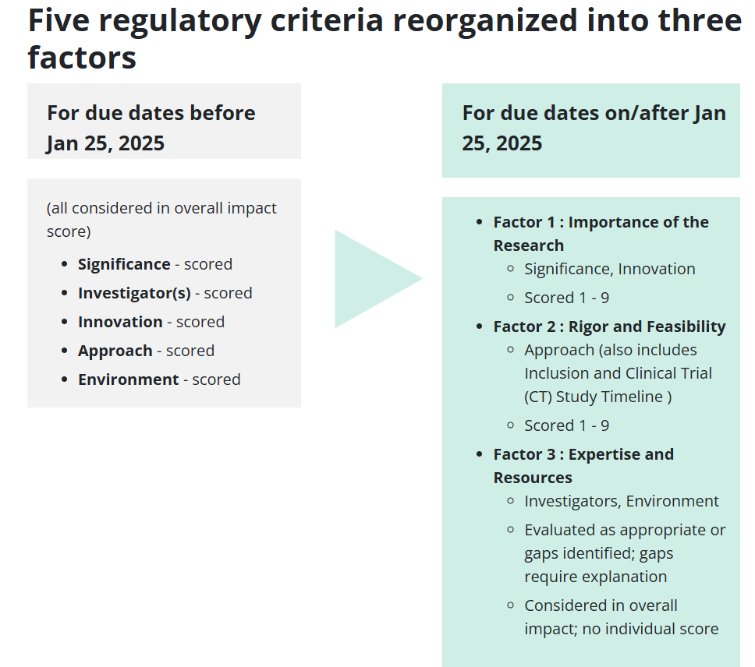
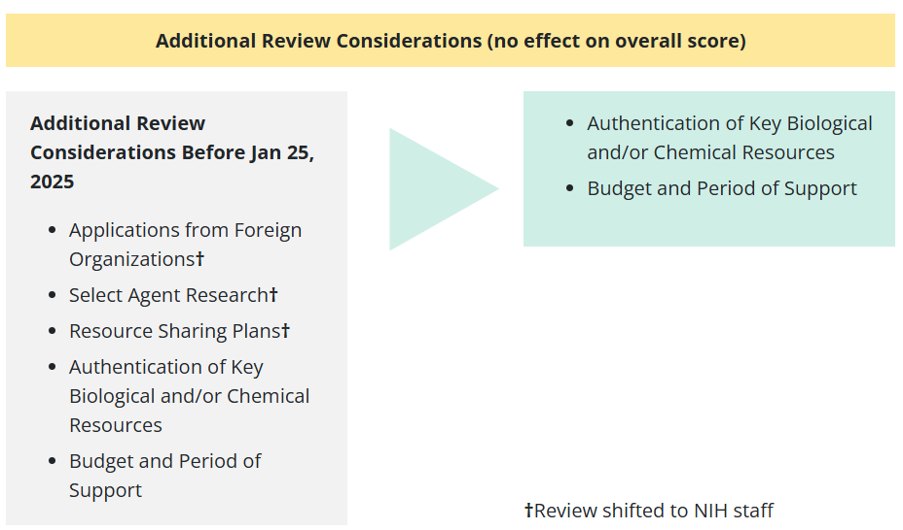
Big Changes for the Standard Review Criteria!
Reframed Criteria Focus:
Importance of the Proposed
  Research
Rigor/Feasibility of Methods
Expertise/Resources
Overall Score/Percentile
Still Provided
Additional Review
Considerations
NIH Grants and Funding: Simplified Review Framework:
https://grants.nih.gov/policy-and-compliance/policy-topics/peer-review/simplifying-review/framework

Slide 8
NIH Staff Roles in Life Cycle of a Grant Application
Stages of Grant | Program Officer | Scientific Review Officer | Grants Management Specialist
Grant Preparation
Grant Submission
Grant Review
Summary Statement
Grant Revision
Grant is Funded

Slide 9

CSR: Become a reviewer

Slide 10
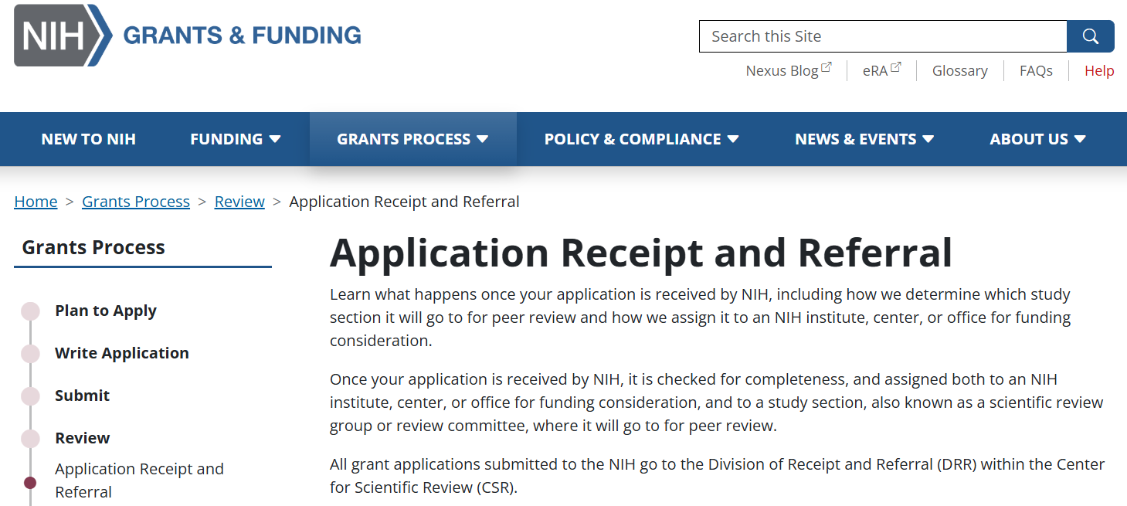
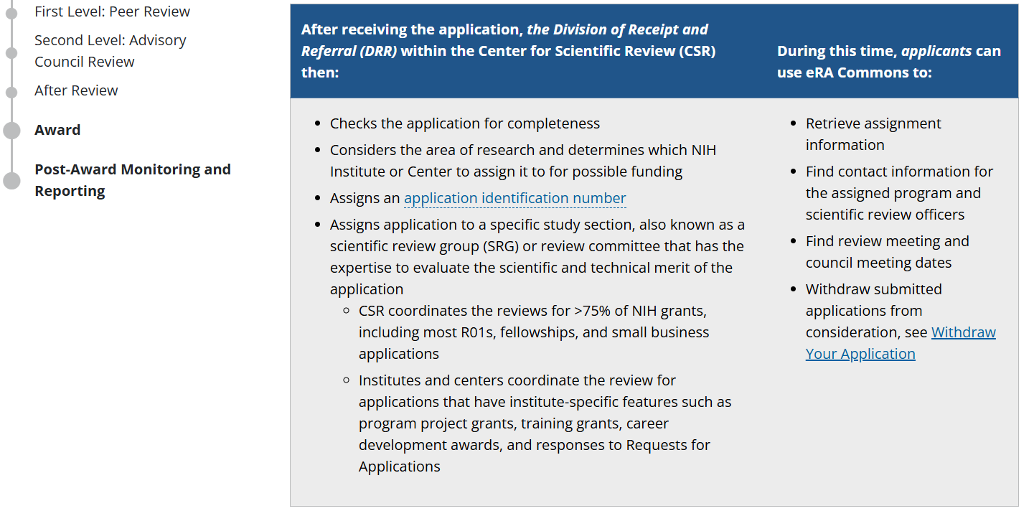
The “First Stop”: Application Receipt and Referral at the NIH Center for Scientific Review
Application checked for completeness
Initial Assignments:
  NIH Institute, Center, or Office
  Application number
  Center for Scientific Review
  Study Section (or for Institute review)
Individual NIH Institute then assigns a
Program Officer
Follow all this in eRA Commons
NIH Grants and Funding: Application Receipt and Referral:
https://grants.nih.gov/grants-process/review/receipt-referral

Slide 11
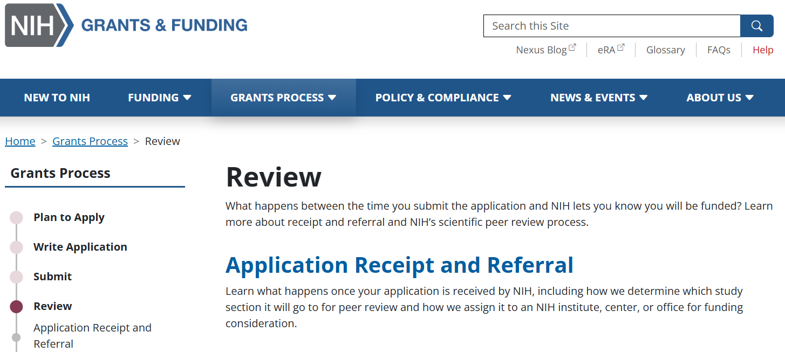
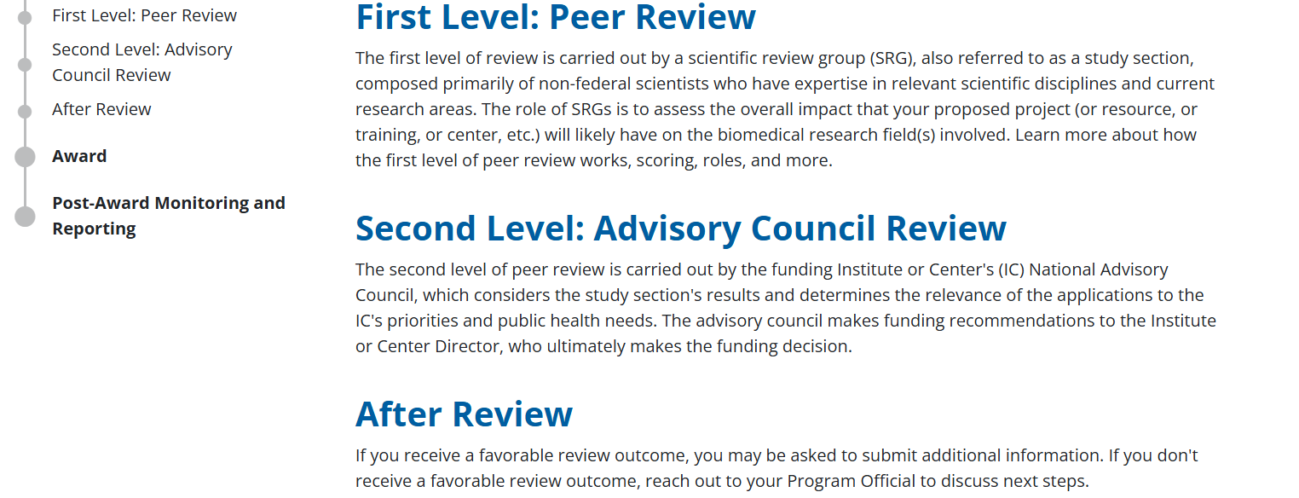
Multiple Levels of Review: Making Funding Decisions
Multiple Levels of Review for Final
Funding Decisions:
  Peer Review (Study Sections)
  Advisory Council
  Program Discussions (Before and After Council Review)
Click Individual Headers
for More Info!
https://grants.nih.gov/grants-process/review
NIH Grants and Funding: Review:
https://grants.nih.gov/grants-process/review

Slide 12
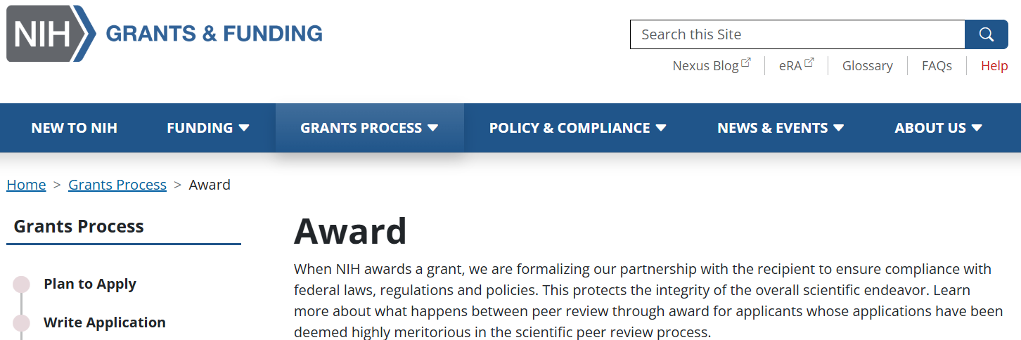
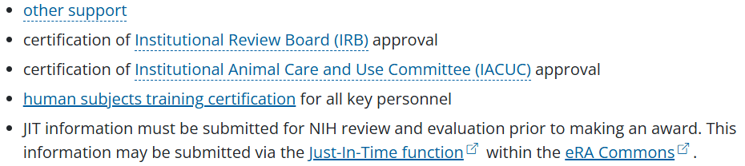
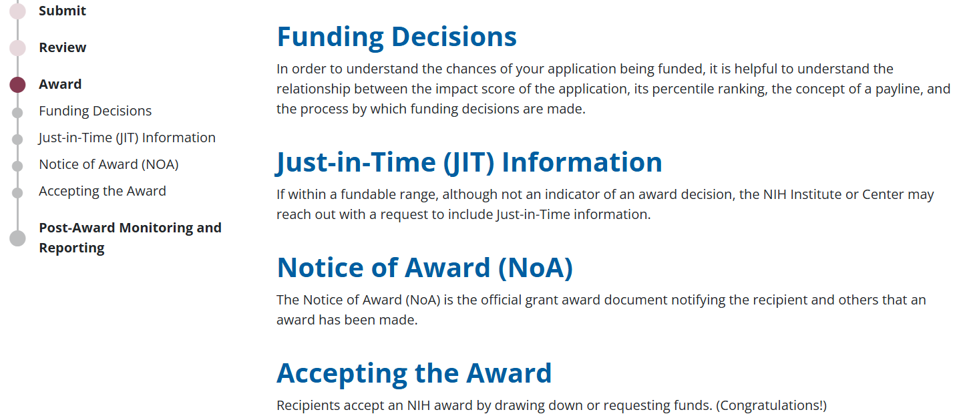
Making the Award and Post-Award
JIT Information:
Notice of Award (NoA):
  Legal document for awarding funds for the budget period
  References subsequent (yearly) budget periods
  Contains all Terms and Conditions of the award
  Issued by the Grants Management Specialist
NIH Grants and Funding: Award: https://grants.nih.gov/grants-process/award

Slide 13
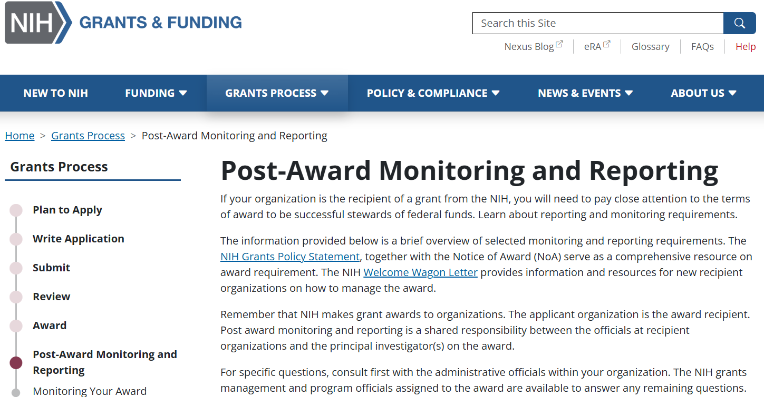
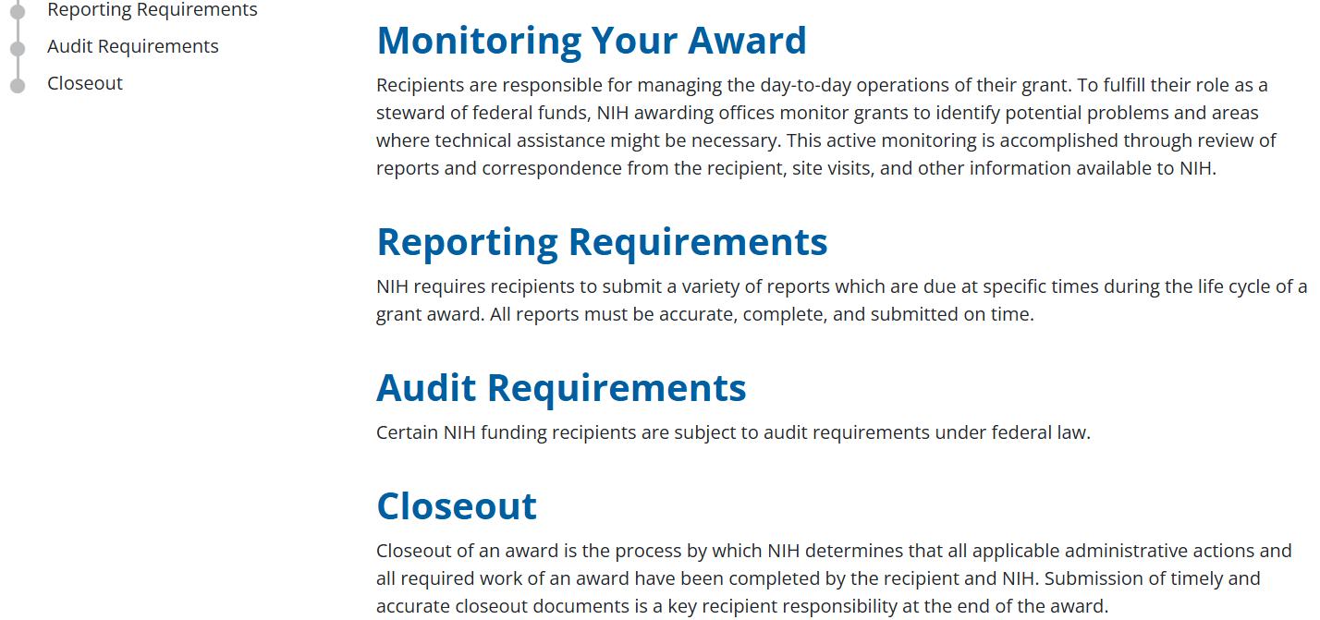
Post-Award Monitoring and Reporting
NIH Makes Awards to Institutions (not to the Investigators)
Work with Your Institutional Grants Office
Reporting Requirements:
  Yearly Research Performance Progress Report (RPPR); Submit via eRA Commons Before the End of Current Budget Year (45 or 60 Days depending)
  Invention Reports
  Yearly Federal Financial Report (FFR)
Reach Out to Your Program Director and Grants Management Specialist, if Needed….
NIH Grants and Funding: Post Award: https://grants.nih.gov/grants-process/post-award-monitoring-and-reporting

Slide 14
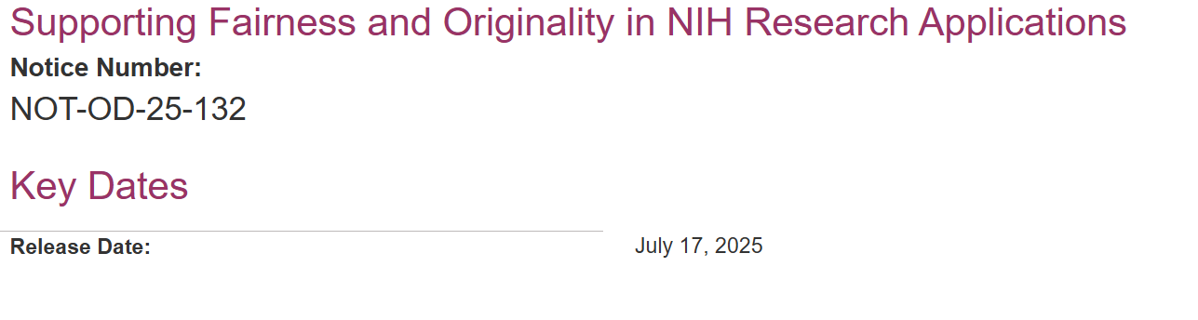
Recent Announcement on AI
NIH will not consider applications that are either substantially developed by AI, or contain sections substantially developed by AI, to be original ideas of applicants.
NIH will only accept six new, renewal, resubmission, or revision applications from an individual Principal Investigator/Program Director or Multiple Principal Investigator for all council rounds in a calendar year.

Slide 15






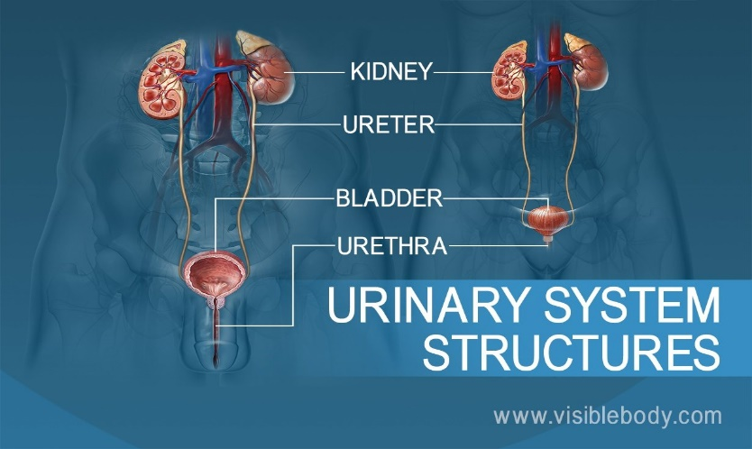
All Research Interests Welcomed (and Needed)!
You don’t have to be a urologist or from a “traditional”
urology training or research background for a career
in urologic disease research!
Understanding and developing treatments for urologic
disease require a “Multi-disciplinary approach”*
(*collaboration among diverse scientific backgrounds)
Mathematics/Statistics
Engineering
Molecular Biology
Clinical Medicine (lots of types)
Biotechnology
Psychology
Microbiology
Genetics
Neurobiology

Slide 16
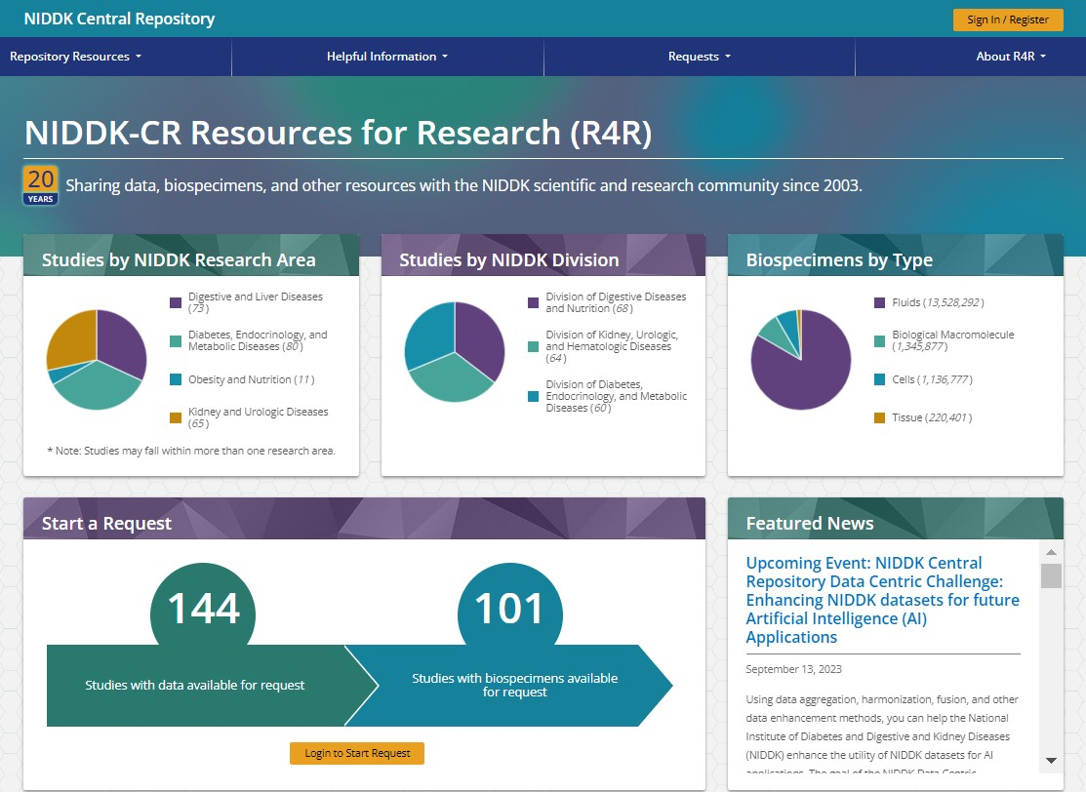
The NIDDK Central Repository
Jumpstart Your Research Study!
Receive access to archived clinical data
and diverse, associated biospecimens and
other materials from large, multi-site NIDDK
clinical trials and studies
What’s There? Searchable for study names,
resources categories, and key words
How? Pathways/Processes for Data and
Biospecimen Requests
NIDDK CR: https://repository.niddk.nih.gov/home/

Slide 17




Opportunities: Data Repository
NIDDK Data Repository – clinical data, biospecimens

Slide 18
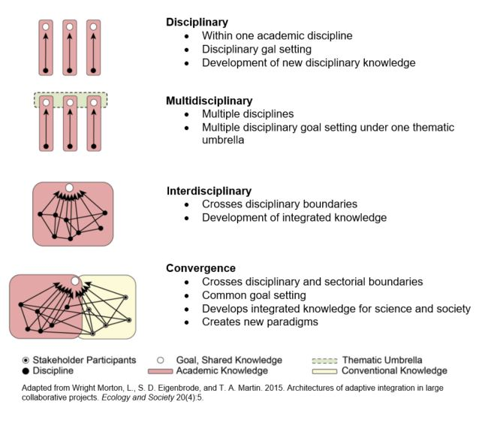
Multidisciplinary – Convergence research
https://research.ncsu.edu/rdo/the-difference-between-multidisciplinary-interdisciplinary-and-convergence-research/
Notes:
https://research.ncsu.edu/rdo/the-difference-between-multidisciplinary-interdisciplinary-and-convergence-research/

Slide 19



Think … Translational
“Bench to Bedside” – direct research towards human/clinical applicability
Find Clinicians to help (advisor? Formal partnership?)
Consider Human-based research technologies – how applicable is method to human anatomy/physiology/disease?
Patients as collaborators, stakeholders

Slide 20
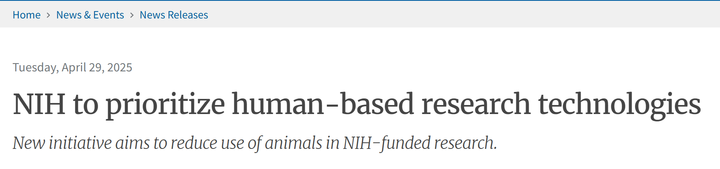
Translational Research
Example technologies:
Organoids, tissue chips, and other in vitro systems that allow scientists to model human disease and capture human variability and patient-specific characteristics.
Computational models which simulate complex biological human systems, disease pathways, and drug interactions.
Real-world data that allow scientists to study health outcomes in humans at community and population levels.
To integrate innovative human-based science, the NIH intends to establish the Office of Research Innovation, Validation, and Application (ORIVA) within NIH’s Office of the Director.

Slide 21
Translational Research
Example technologies:
Organoids, tissue chips, and other in vitro systems that allow scientists to model human disease and capture human variability and patient-specific characteristics.
Computational models which simulate complex biological human systems, disease pathways, and drug interactions.
Real-world data that allow scientists to study health outcomes in humans at community and population levels.
To integrate innovative human-based science, the NIH intends to establish the Office of Research Innovation, Validation, and Application (ORIVA) within NIH’s Office of the Director.

Slide 22
A conceptual framework for LUTS etiology
(Prevention of Lower Urinary tract Symptoms (PLUS) among girls and women)
Brady et al,
Neurourol Urodyn, 2018
Notes:
FIGURE 1 Prevention of Lower Urinary tract Symptoms (PLUS) among girls and women: A conceptual framework adapted from Glass and McAtee51
Figure 1 depicts a condensed version of the PLUS conceptual framework to guide studies investigating the etiology and prevention of LUTS and promotion of bladder health. This framework shows how environmental risk and protective factors (eg, constrained or unconstrained toilet access) can become embodied in the structure and functioning of biological systems that affect bladder health and the development of LUTS. The framework also includes the potential for gene-by-environment interactions. Genetic and biological predispositions toward bladder health and the development of LUTS may be more likely to be expressed in specific social and environmental contexts. Throughout the life course, individual behavior is a critical determinant of bladder health and LUTS. Whereas Glass and McAtee51 depicted behavior within an arrow representing the life course, the PLUS Consortium depicts bladder health and LUTS within this arrow (see center of Figure 1). Behavior is grouped with cognitive, affective, and psychosocial attributes of the individual.
The Prevention of Lower Urinary Tract Symptoms (PLUS) in girls and women: Developing a conceptual framework for a prevention research agenda
Brady et al, Neurourology and Urodynamics. 2018;37:2951–2964
Figure 2. Hidden burden of noncancerous genitourinary conditions (NCGUCs) framework. (Adapted from Glass & McAtee, 2006). (Color version available online.)
Brady, Sonya S., Tamara G. Bavendam, Christine K. Bradway, Britt Conroy, Annemarie Dowling-Castronovo, Cynthia Neill Epperson, Adonis K. Hijaz, et al. 2022. “Noncancerous Genitourinary Conditions as a Public Health Priority: Conceptualizing the Hidden Burden.” Urology 166 (August): 39–49.

Slide 23
Etiology of LUTS
Brady et al,
Neurourol Urodyn, 2018
Notes:
FIGURE 1 Prevention of Lower Urinary tract Symptoms (PLUS) among girls and women: A conceptual framework adapted from Glass and McAtee51
Figure 1 depicts a condensed version of the PLUS conceptual framework to guide studies investigating the etiology and prevention of LUTS and promotion of bladder health. This framework shows how environmental risk and protective factors (eg, constrained or unconstrained toilet access) can become embodied in the structure and functioning of biological systems that affect bladder health and the development of LUTS. The framework also includes the potential for gene-by-environment interactions. Genetic and biological predispositions toward bladder health and the development of LUTS may be more likely to be expressed in specific social and environmental contexts. Throughout the life course, individual behavior is a critical determinant of bladder health and LUTS. Whereas Glass and McAtee51 depicted behavior within an arrow representing the life course, the PLUS Consortium depicts bladder health and LUTS within this arrow (see center of Figure 1). Behavior is grouped with cognitive, affective, and psychosocial attributes of the individual.
The Prevention of Lower Urinary Tract Symptoms (PLUS) in girls and women: Developing a conceptual framework for a prevention research agenda
Brady et al, Neurourology and Urodynamics. 2018;37:2951–2964
Figure 2. Hidden burden of noncancerous genitourinary conditions (NCGUCs) framework. (Adapted from Glass & McAtee, 2006). (Color version available online.)
Brady, Sonya S., Tamara G. Bavendam, Christine K. Bradway, Britt Conroy, Annemarie Dowling-Castronovo, Cynthia Neill Epperson, Adonis K. Hijaz, et al. 2022. “Noncancerous Genitourinary Conditions as a Public Health Priority: Conceptualizing the Hidden Burden.” Urology 166 (August): 39–49.

Slide 24
Etiology of LUTS
Brady et al,
Neurourol Urodyn, 2018
Notes:
FIGURE 1 Prevention of Lower Urinary tract Symptoms (PLUS) among girls and women: A conceptual framework adapted from Glass and McAtee51
Figure 1 depicts a condensed version of the PLUS conceptual framework to guide studies investigating the etiology and prevention of LUTS and promotion of bladder health. This framework shows how environmental risk and protective factors (eg, constrained or unconstrained toilet access) can become embodied in the structure and functioning of biological systems that affect bladder health and the development of LUTS. The framework also includes the potential for gene-by-environment interactions. Genetic and biological predispositions toward bladder health and the development of LUTS may be more likely to be expressed in specific social and environmental contexts. Throughout the life course, individual behavior is a critical determinant of bladder health and LUTS. Whereas Glass and McAtee51 depicted behavior within an arrow representing the life course, the PLUS Consortium depicts bladder health and LUTS within this arrow (see center of Figure 1). Behavior is grouped with cognitive, affective, and psychosocial attributes of the individual.
The Prevention of Lower Urinary Tract Symptoms (PLUS) in girls and women: Developing a conceptual framework for a prevention research agenda
Brady et al, Neurourology and Urodynamics. 2018;37:2951–2964
Figure 2. Hidden burden of noncancerous genitourinary conditions (NCGUCs) framework. (Adapted from Glass & McAtee, 2006). (Color version available online.)
Brady, Sonya S., Tamara G. Bavendam, Christine K. Bradway, Britt Conroy, Annemarie Dowling-Castronovo, Cynthia Neill Epperson, Adonis K. Hijaz, et al. 2022. “Noncancerous Genitourinary Conditions as a Public Health Priority: Conceptualizing the Hidden Burden.” Urology 166 (August): 39–49.

Slide 25
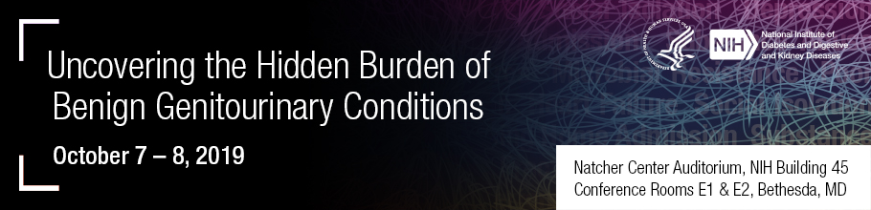
Upstream vs. Downstream impacts:
Hidden burden of GU conditions
Brady et al, Urology, 2022
Notes:
Figure 1. Distinguishing between upstream and downstream factors in relation to NCGUCs. NCGUCs, noncancerous genito- urinary conditions. (Color version available online.)
Noncancerous Genitourinary Conditions as a Public Health Priority: Conceptualizing the Hidden Burden
Brady et al. Urology, 2021

Slide 26
Downstream impacts of Urinary conditions
(Uncovering the Hidden burden of GU conditions, NIDDK Workshop 2019)
Brady et al, Urology, 2022
Notes:
FIGURE
Figure 2. Hidden burden of noncancerous genitourinary conditions (NCGUCs) framework. (Adapted from Glass & McAtee, 2006). (Color version available online.)
Brady, Sonya S., Tamara G. Bavendam, Christine K. Bradway, Britt Conroy, Annemarie Dowling-Castronovo, Cynthia Neill Epperson, Adonis K. Hijaz, et al. 2022. “Noncancerous Genitourinary Conditions as a Public Health Priority: Conceptualizing the Hidden Burden.” Urology 166 (August): 39–49.

Slide 27
Downstream impacts
Brady et al, Urology, 2022
Notes:
FIGURE
Figure 2. Hidden burden of noncancerous genitourinary conditions (NCGUCs) framework. (Adapted from Glass & McAtee, 2006). (Color version available online.)
Brady, Sonya S., Tamara G. Bavendam, Christine K. Bradway, Britt Conroy, Annemarie Dowling-Castronovo, Cynthia Neill Epperson, Adonis K. Hijaz, et al. 2022. “Noncancerous Genitourinary Conditions as a Public Health Priority: Conceptualizing the Hidden Burden.” Urology 166 (August): 39–49.

Slide 28
Downstream impacts
Brady et al, Urology, 2022
Notes:
FIGURE
Figure 2. Hidden burden of noncancerous genitourinary conditions (NCGUCs) framework. (Adapted from Glass & McAtee, 2006). (Color version available online.)
Brady, Sonya S., Tamara G. Bavendam, Christine K. Bradway, Britt Conroy, Annemarie Dowling-Castronovo, Cynthia Neill Epperson, Adonis K. Hijaz, et al. 2022. “Noncancerous Genitourinary Conditions as a Public Health Priority: Conceptualizing the Hidden Burden.” Urology 166 (August): 39–49.

Slide 29


How can we (NIH/NIDDK) help?
Identify major roadblocks/hurtles facing research community
Suggest opportunities for additional $ emphasis

Slide 30
Thank you
Questions?
Stuart.Reynolds@nih.gov
William.Reynolds@nih.gov

