Slide 1


Welcome

Slide 2
WHY a Research Strategy Sprint?

Slide 3
The “sprint”
Structured yet flexible leg of the journey
Built around a series of focused, facilitated sessions
Each phase is time-conscious
Assessment
Visioning
Refining
Prioritizing
Planning
Strategizing
Doing
Groups not focused on any one disease or disorder
Rather, grouped by:
Systemic process (aging)
Common thread (urobiome)
Category of disorders (voiding dysfunction)

Slide 4
Background
Conversations with CAIRIBU investigators
Experience with CAIRIBU Urobiome Research Interest Group
Enthusiasm for additional research interest groups (communities of practice)
Increasing capacity of CAIRIBU Interactions Core and collaborators
Support for another 5 years
Current environment, increased need to be strategic

Slide 5
Planning
March
Conceptual development
April
Discussions with group leaders
Outreach/invitations to investigators within each research area
May
Design, planning
June/July
Refine, logistics

Slide 6
Our strategic objectives
We aim to:
Identify knowledge gaps and most critical research questions
Identify and study shared pathophysiologic mechanisms
Reframe classification based on biology, not symptoms
Seek novel transdisciplinary research pathways for our research
Collaborate beyond silos to stimulate innovation
Coordinate our individual efforts along a unifying roadmap

Slide 7
Highlights
CAIRIBU Interactions Core
Mariana Coughlin, MS
Muen Wang
Theo Ng
Anna Barrett
Isaac Yang
Edison Chiu
Logistical coordination overall
Event planning
Tech support within breakout groups
Evaluation process
Preparatory and follow-up work
Thomas Chi, MD, MBA, UAB
Chris Mullins, PhD, NIH/NIDDK
Stu Reynolds, MD, PhD, NIH/NIDDK
Leaders:
Scott Bauer, MD, MS & Indira Mysorekar, PhD
Margot Damaser, PhD & Nathan Tykocki, PhD
Nicole De Nisco, PhD & Lisa Karstens, PhD
Skilled facilitators:
Whitney Sweeney, PhD, UW-Madison
Lori Uttech-Hanson, MA Ed, UW-Madison
Invited speakers within groups:
Iman Al-Naggar, PhD (Uro-Aging group), UConn
Kristin Ebert, MD (voiding dysfunction group), UW-Madison

Slide 8
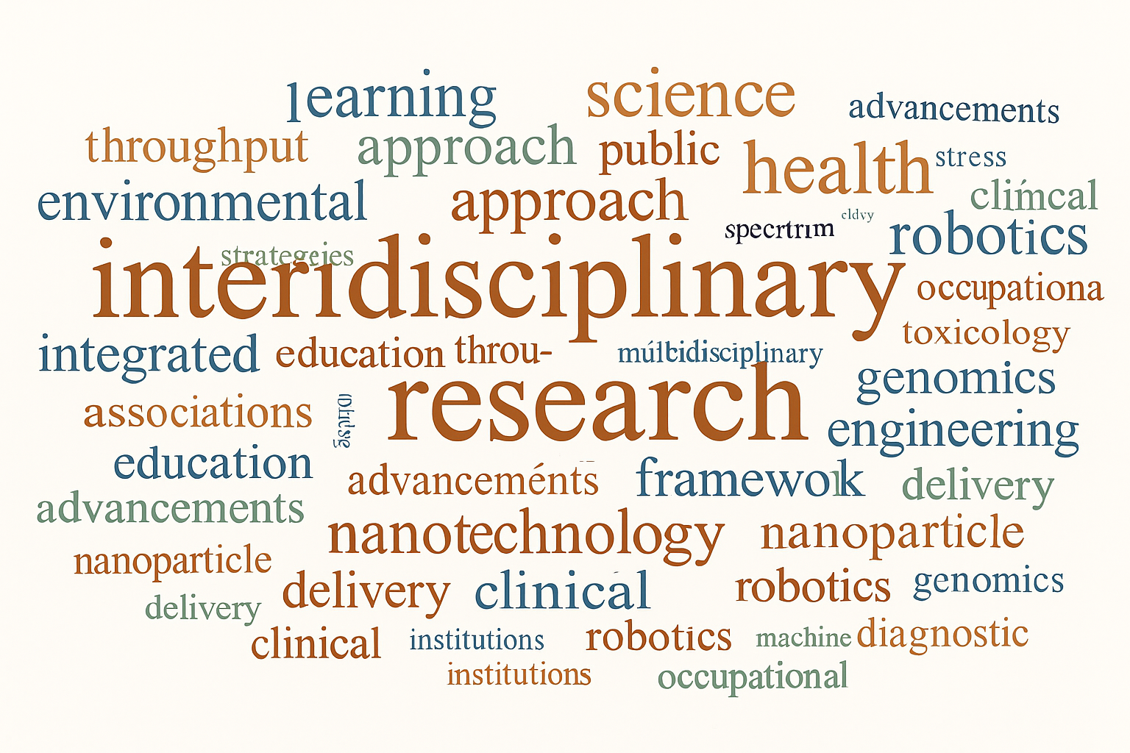
Dr. Damaser

Slide 9
Kris Penniston, PhD UW-Madison
Developing a Roadmap for Translational Research in Genitourinary Science

Slide 10
Main points
Urogenital research ripe for interdisciplinary collaborative research and may be enabled by:
Clinician-basic scientist interactions and collaboration
Centralized coordination
Strategic planning
Changes in research “climate” require new approaches
Solutions
Strategic leadership, central coordination, and collaborative research interest groups

Slide 11
Shared pathophysiology in LUT
Common, overlapping pathophysiological mechanisms
Muscular
Neural
Vascular
Inflammatory
Genetic
Environmental
Aging
Shared approaches
Molecular (e.g., cytokine networks)
Cellular (e.g., stromal profiling)
Systems-level (e.g., hormonal feedback loops)
Heterogeneity in disease presentation and progression
Overlapping symptoms across different pathophysiologic processes

Slide 12
Opportunities for strategic collaboration
Achieve high-impact integration
Microbiome Lower urinary tract inflammation
Brain Bladder function/dysfunction
AI Functional bladder modeling
Bioengineers Organoids, nanotechnology
Behavioral scientists Phenotyping, patient-reported outcomes
Clinical trialists More efficient and effective clinical studies
Enablers:
Cross-laboratory grants, shared biobanks, interdisciplinary teams, central coordination

Slide 13
Heterogeneity of LUTD
Limitations of urgency-, frequency-, and pain-based categories
Biological phenotyping needed:
Diagnostic accuracy, treatment targeting, precision medicine

Slide 14
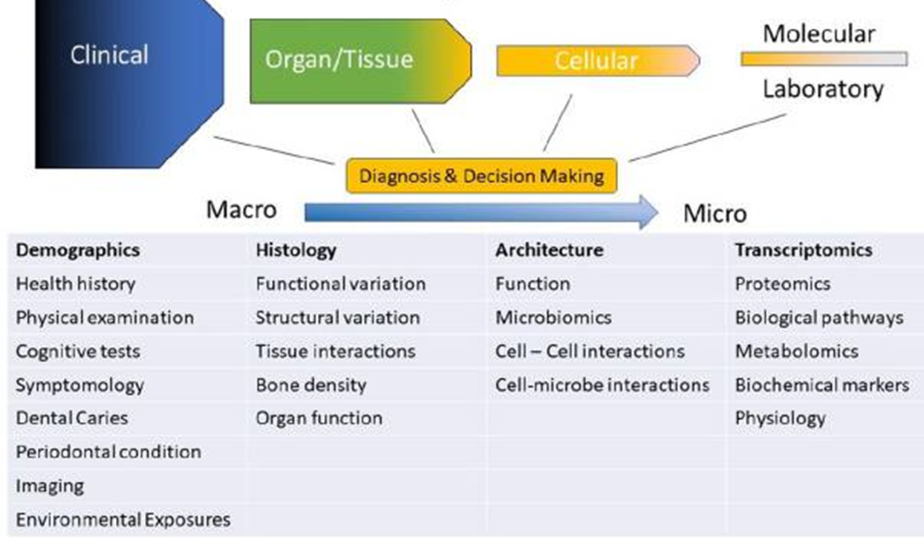
Defining the phenome: an interdisciplinary pursuit
Wright and Herzberg, J Dent Res 2021;100(8):785-89

Slide 15
Main points
Urogenital research ripe for interdisciplinary collaborative research and enabled by:
Clinician-basic scientist interactions and collaboration
Centralized coordination
Strategic planning
Changes in research “climate”
Solutions
Strategic leadership, central coordination, and collaborative research interest groups

Slide 16
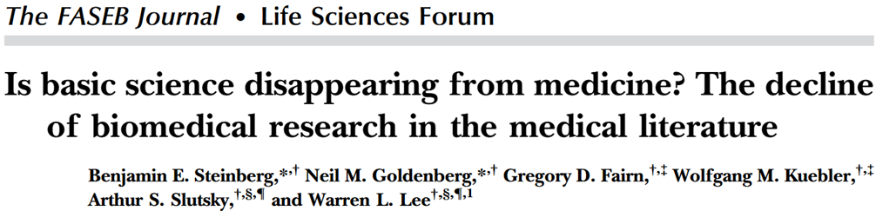
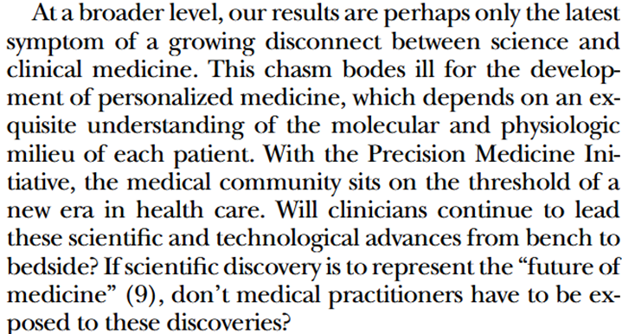
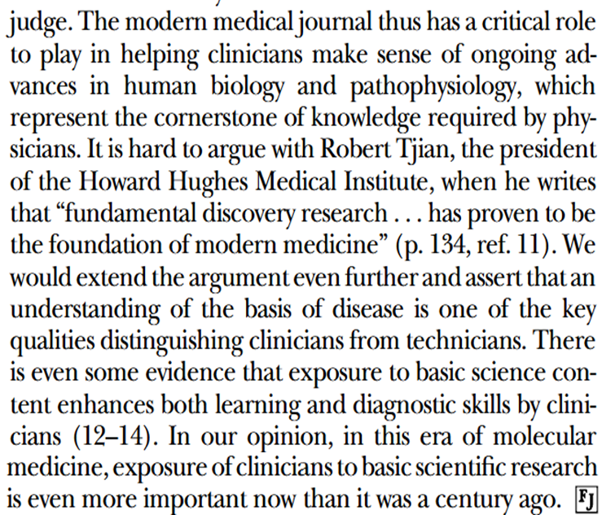

Slide 17
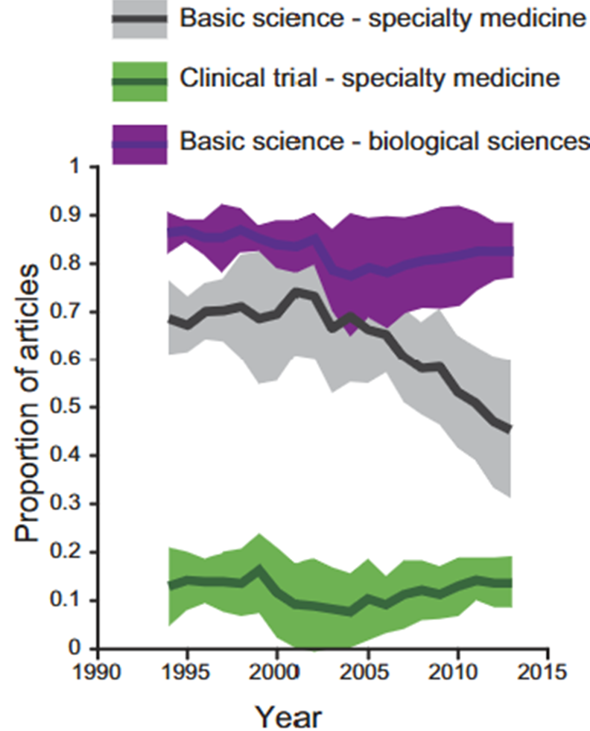
Less basic science…
Widens the clinical – basic science divide

Slide 18
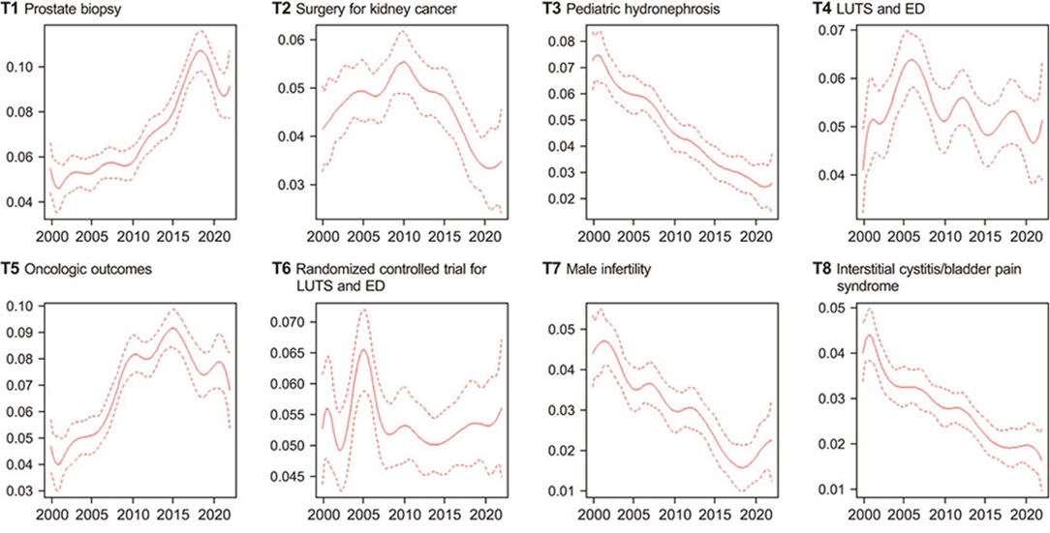
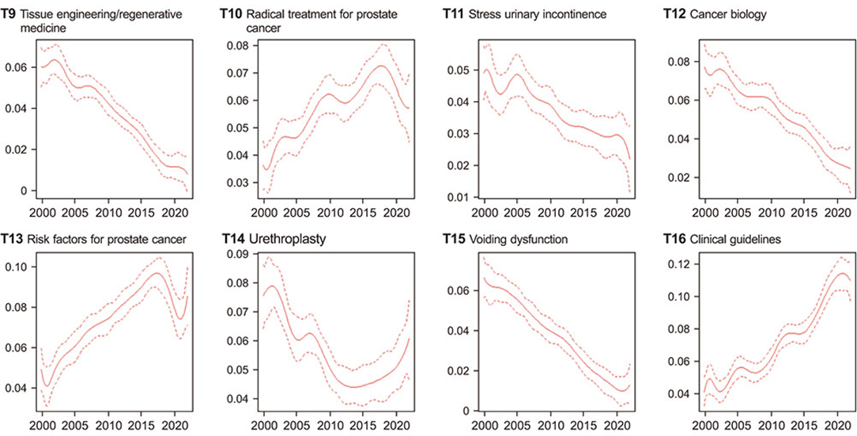
Less benign urology
27,100 articles
Eur Urol
J Urol
BJU Int
World J Urol
Investig Clin Urol 2025 Mar;66(2):172-180

Slide 19
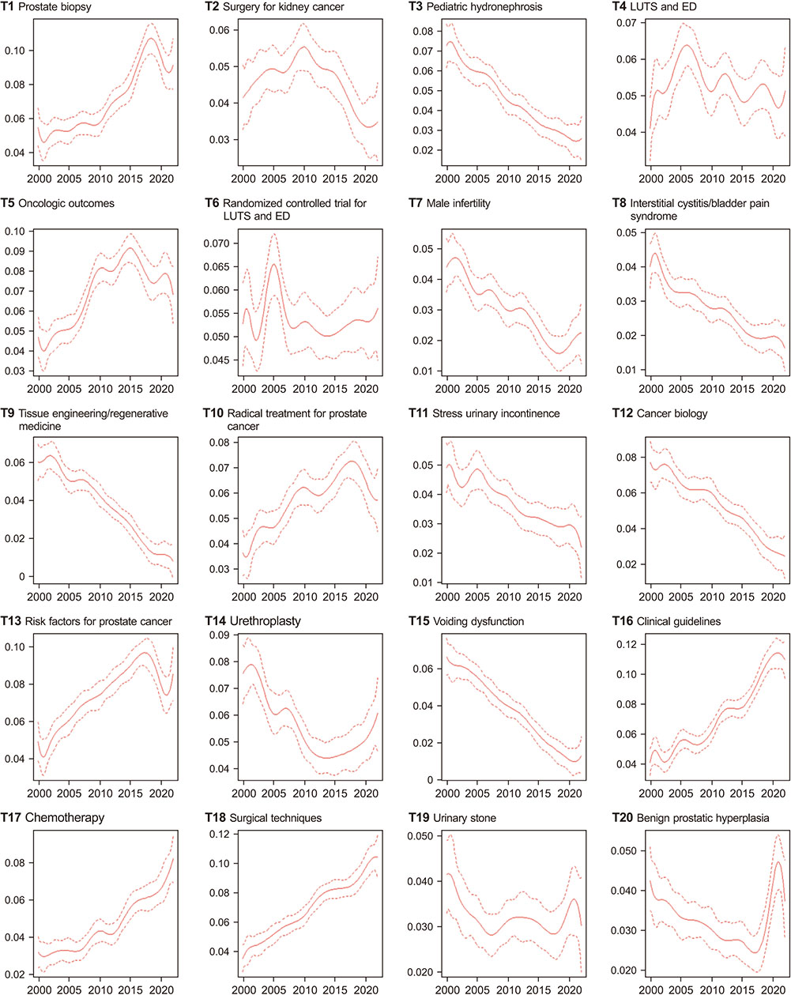
Investig Clin Urol 2025 Mar;66(2):172-180

Slide 20
Less research funding
>$3.2 billion in NIH funding terminated since March 2025 (excludes reinstated grants)
In total, 2,548 grants terminated; 2,468 currently inactive (80 grants reinstated)
Harvard Med School has most terminations, 340 > Columbia University, 166 > Harvard School of Public Health, 158
Most terminations focused on public health and diversity
MA, NY, and NC lost more NIH funding than all other states, accounting for >68% of all NIH dollars rescinded (Massachusetts alone lost $1.27 billion)
New NIH grants still being issued; there were 78,354 active NIH grants as of 6/17/2025, up from 77,807 the week prior
Most common keywords in terminated grant abstracts
Cell
Training
Students
Biomedical
Community
Disparities
Grant Watch: a volunteer-led project that tracks terminated scientific research grants from NIH and NSF under Trump in 2025. Data are collected from various sources, including self-reports from affected researchers, federal databases such as NIH RePORTER, TAGGS, and USASpending.gov, as well as news reports and social media.

Slide 21
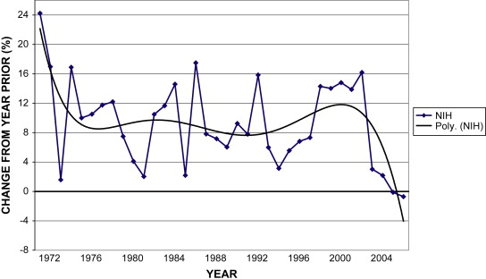
Have we ever been here before?
Rapid growth in NIH budget
Ellison and Olsson, 2009 Urol Clin N Am 36:85-93
National Institute of Arthritis, Metabolism, and Digestive Diseases renamed to National Institute of Arthritis, Diabetes, and Digestive and Kidney Diseases
- # of scientists submitting RPGs grew by 75% (20K to 35K)
- Proposals were funded at the 30% level

Slide 22
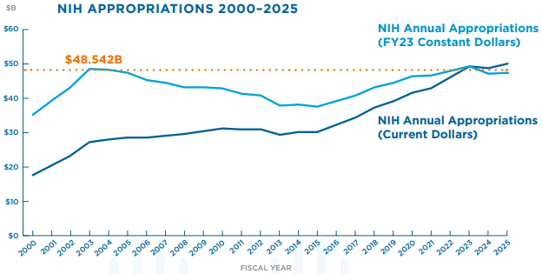
FY 2026 request = $18.1B reduction
$27.90B
United for Medical Research, https://www.unitedformedicalresearch.org/wp-content/uploads/2024/08/UMR-Response-Letter_E-C-Committee-NIH-Reform-Framework.pdf
2026

Slide 23
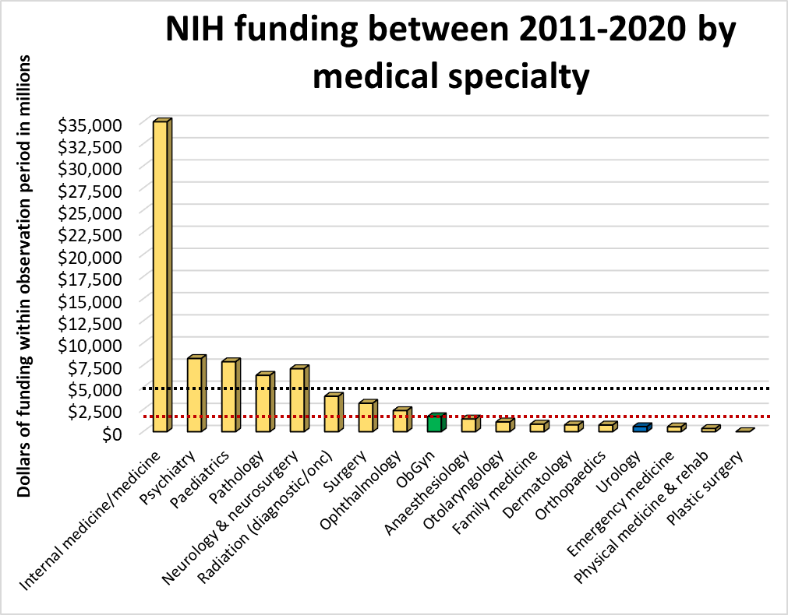
Grant types included in search:
F32, T32
K01, K08, K23
R01, R03, R21
P30, U01
Adapted from Schlafly and Sebro, BMJ Open 2022;12:e058191

Slide 24
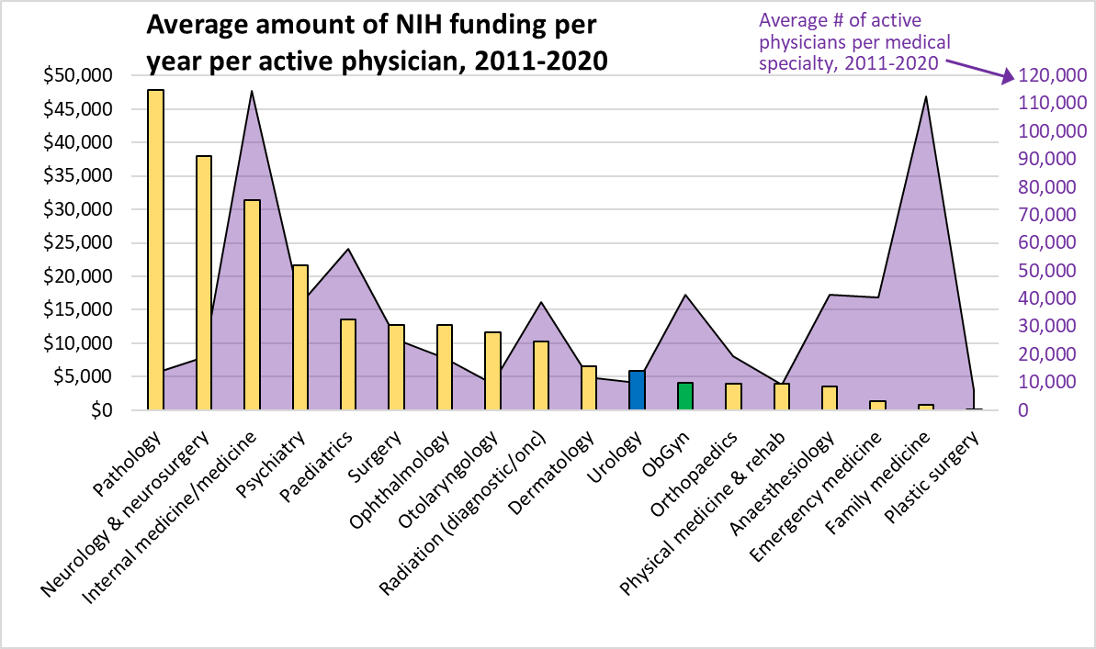
Grant types included in search:
F32, T32
K01, K08, K23
R01, R03, R21
P30, U01
Adapted from Schlafly and Sebro, BMJ Open 2022;12:e058191

Slide 25
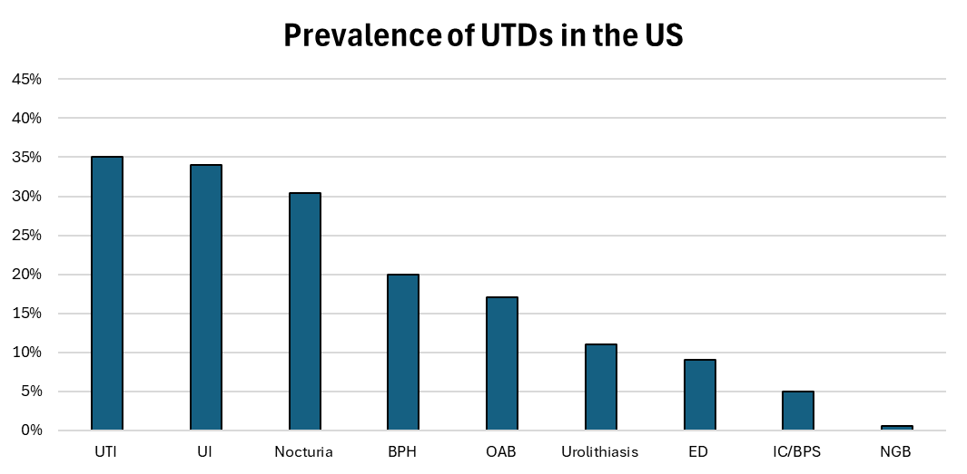
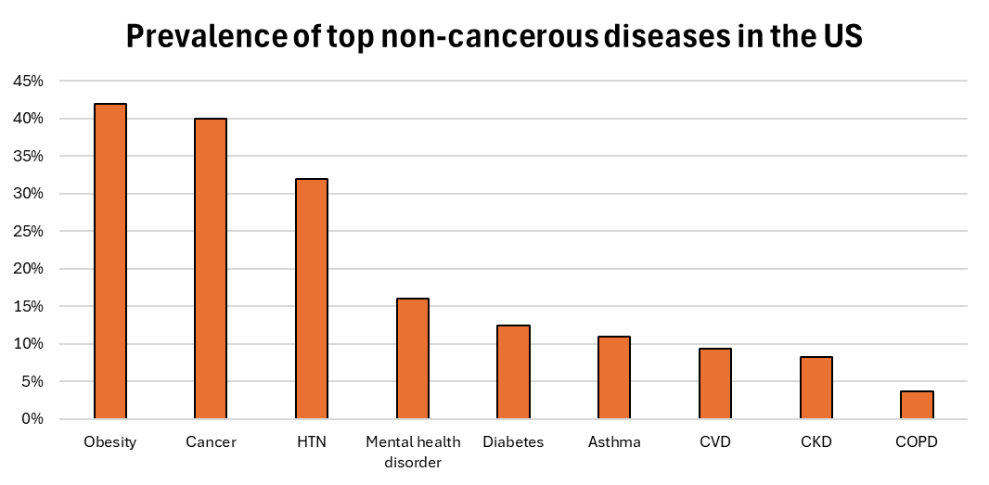
Prevalence of top diseases in the US
Data from Urologic Diseases in America, Annual Data Report, 2024

Slide 26
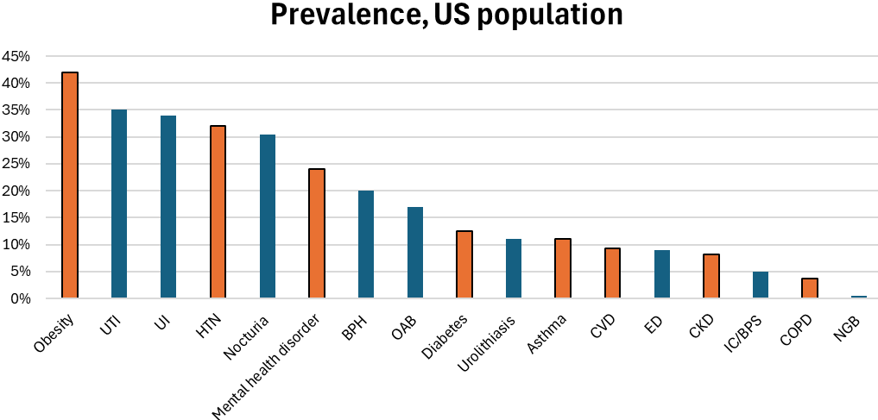
Research funding
Data from Urologic Diseases in America, Annual Data Report, 2024

Slide 27
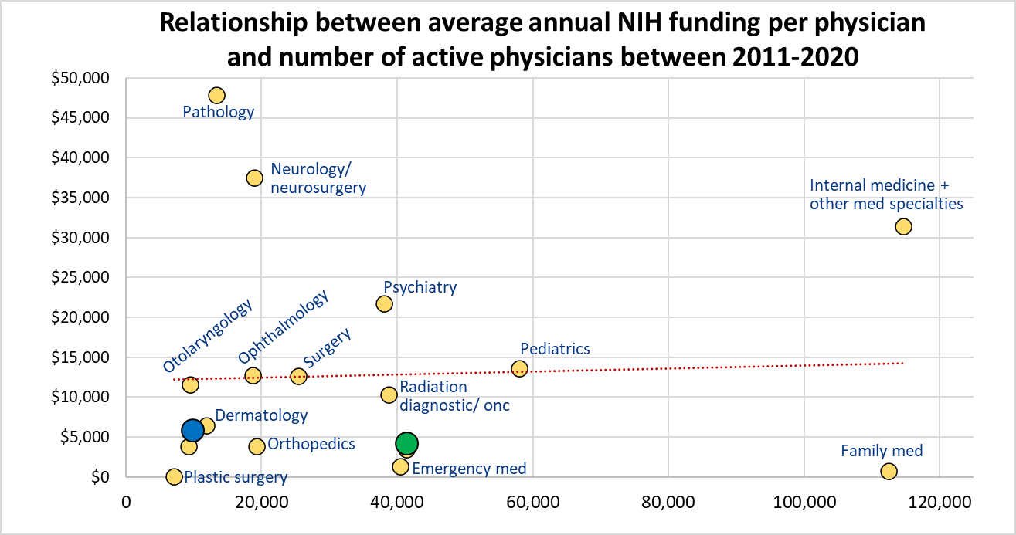
Adapted from Schlafly and Sebro, BMJ Open 2022;12:e058191

Slide 28
Main points
Urogenital research ripe for interdisciplinary collaborative research and enabled by:
Clinical interactions and insights
Coordination
Strategic approach
Changes in research “climate”
Solutions:
Cross-talk, information exchange, clinical interactions, strategic leadership, central coordination, and collaborative research interest groups

Slide 29
What do patients need?
Better pain control
Greater access to the appropriate urology/urogyn experts
More knowledgeable and effective providers
More research
De-stigmatize urinary tract dysfunction and related disorders
More and better information about their conditions
From the National Institute of Diabetes and Digestive and Kidney Diseases Urology Interagency Coordinating Committee Meeting, June 2024

Slide 30
What do clinicians need?
Non-invasive diagnostic technologies (including in vivo), e.g., imaging, biomarkers
Standardized definitions and terminology for UTD-related symptoms
Novel and standardized research approaches to phenotyping patients and studying treatment responsiveness
Increased public awareness of rising incidence and debilitating effects
Patient-centered outcomes – identify, standardize, and utilize across all UTDs and clinical trials
Evidence and best practices for transitional care from childhood to adulthood to geriatric to palliative life stages
From the National Institute of Diabetes and Digestive and Kidney Diseases Urology Interagency Coordinating Committee Meeting, June 2024

Slide 31
What do scientists need?
More funding, esp for pathogenesis of UTDs
Non-invasive research technologies
Alternatives to rodent models
Easier, simplified, streamlined access to data and samples
Support for making data and samples sharable
Better understanding of heterogeneous expression of UTDs across the population spectrum
Support for specific training and education needs
Interactions and collaboration with clinicians and patients to develop research approaches to phenotype by pathology, not symptoms

Slide 32
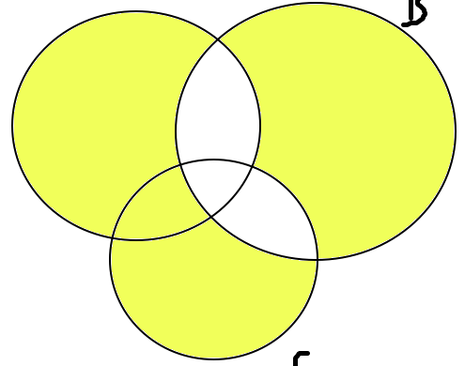
Intersections of these needs
Identify strategic and novel research opportunities that expand interdisciplinary collaboration potential:
Specific populations: women, cancer survivors
PROs: impacts on mental health, QOL, psycho-social functioning, and patients’ self-efficacy
Social and environmental drivers of urogenital health
Identify common research questions & approaches across UTD research:
Influence of microbiota – functional microbial map across LUT
Influence of fibrosis – explore systemic vs. organ-specific processes
Influence of aging – common processes across LUT
Biological phenotyping – to gain new insights into pathophysiology, disease expression, symptoms, and treatment responsiveness
From the National Institute of Diabetes and Digestive and Kidney Diseases Urology Interagency Coordinating Committee Meeting, June 2024

Slide 33
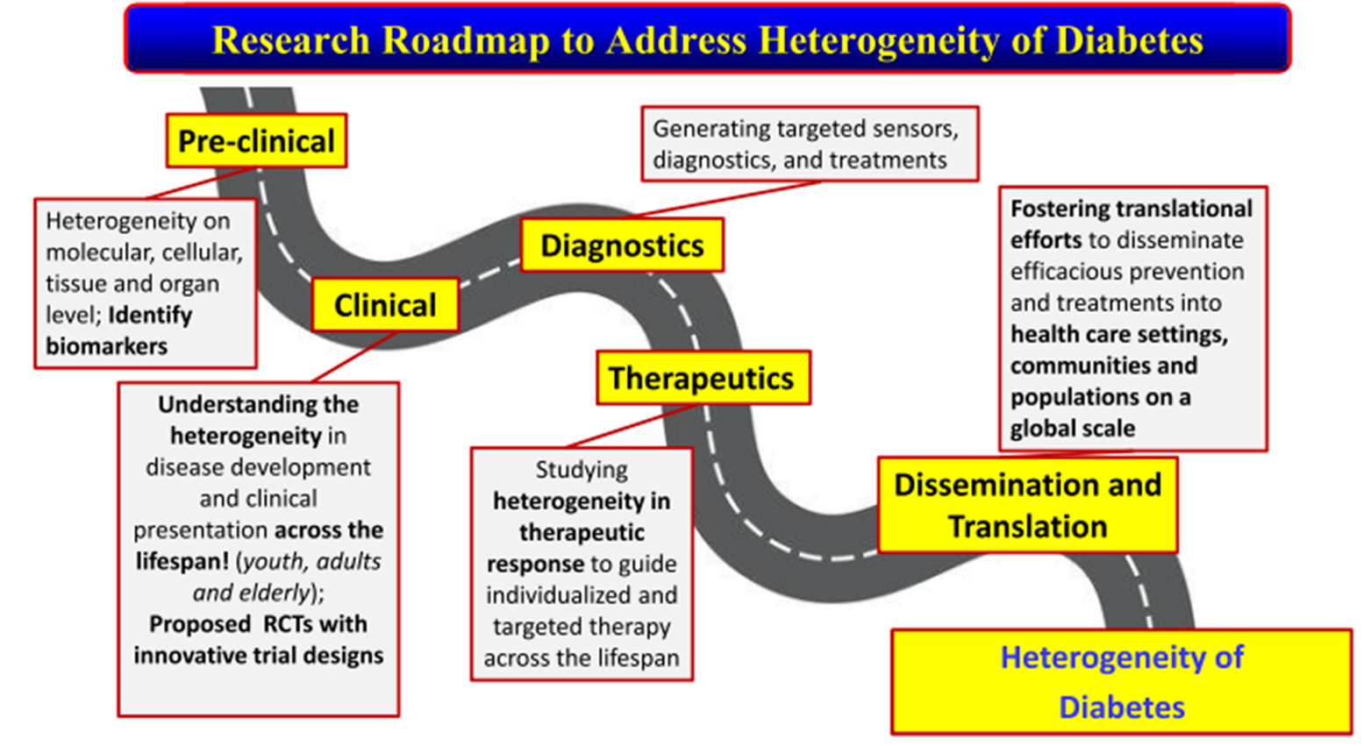
Research roadmap for UTD
Heterogeneity of urinary tract dysfunction
Modified from Franks et al, J Clin Endocrinol Metab 2025;110(3):601-10

