Slide 1




CAIRIBU 2025 Research Strategy Sprint
Margot S. Damaser, PhD
Professor, Dept of Biomedical Engineering and Glickman Urological and Kidney Institute,
Cleveland Clinic Lerner College of Medicine, Case Western Reserve University,
Cleveland, OH
and
Senior Rehabilitation Research Career Scientist
and Deputy Director, Advanced Platform Technology Center
Louis Stokes Cleveland VA Medical Center, Cleveland, OH
damasem@ccf.org

Slide 2
Disclosures
I have multiple patents and patent applications on:
Regenerative approaches for Urogenital applications
Bladder and colon function monitoring devices & algorithms
We have licensed IP to TDOC, SRS Medical, and Bright Uro
We have optioned IP to Theratome Bio
I currently have collaborative research with SRS Medical, Bright Uro, Rebeda Tek, Versameb, and Kashiv Pharmaceuticals
I have had collaborative research agreements with Medtronic, Theratome Bio, Novartis, Acorda, Eli Lilly, TDOC, Beachtree, Fate, AMS, Dynaventions, and Pharmacia-Upjohn
I have a consultant arrangement with Versameb

Slide 3







Research Encompasses the Entire Research Ecosystem
Scientists & Researchers
Physicians & Clinical Caregivers
Community Members
Companies
Research Animals
Patients & Research Subjects

Slide 4
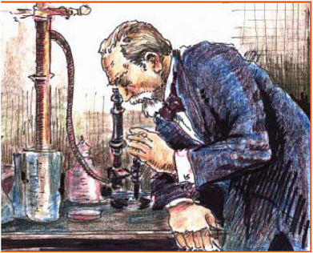
Basic Research is the Bedrock of Advances in Research

Slide 5
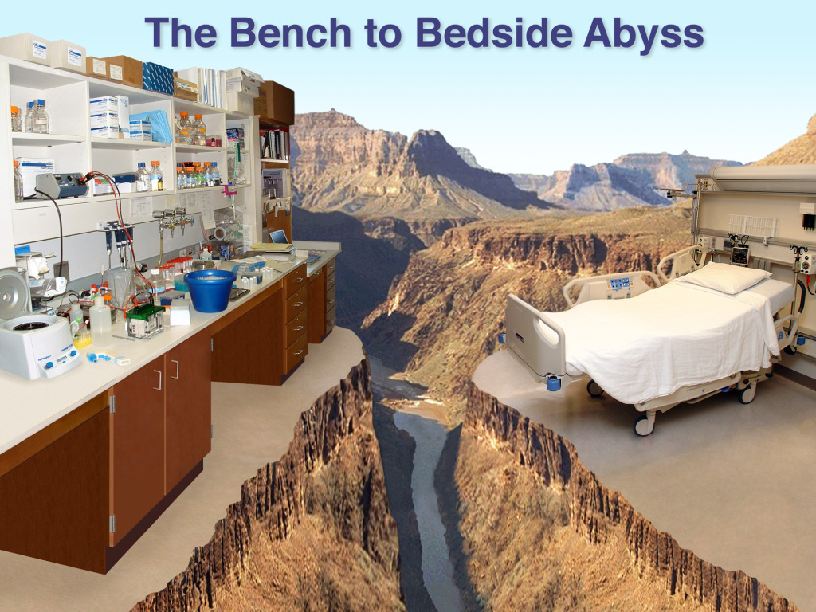
Applied Research Bridges Bench to Bedside

Slide 6
All we accomplish, we accomplish together
Scientists & Researchers
Physicians & Clinical Caregivers
Community Members
Companies
Research Animals
Patients & Research Subjects

Slide 7

All Science is Team Science Now

